Slide 1

CEOS contributions to ASP

Slide 2
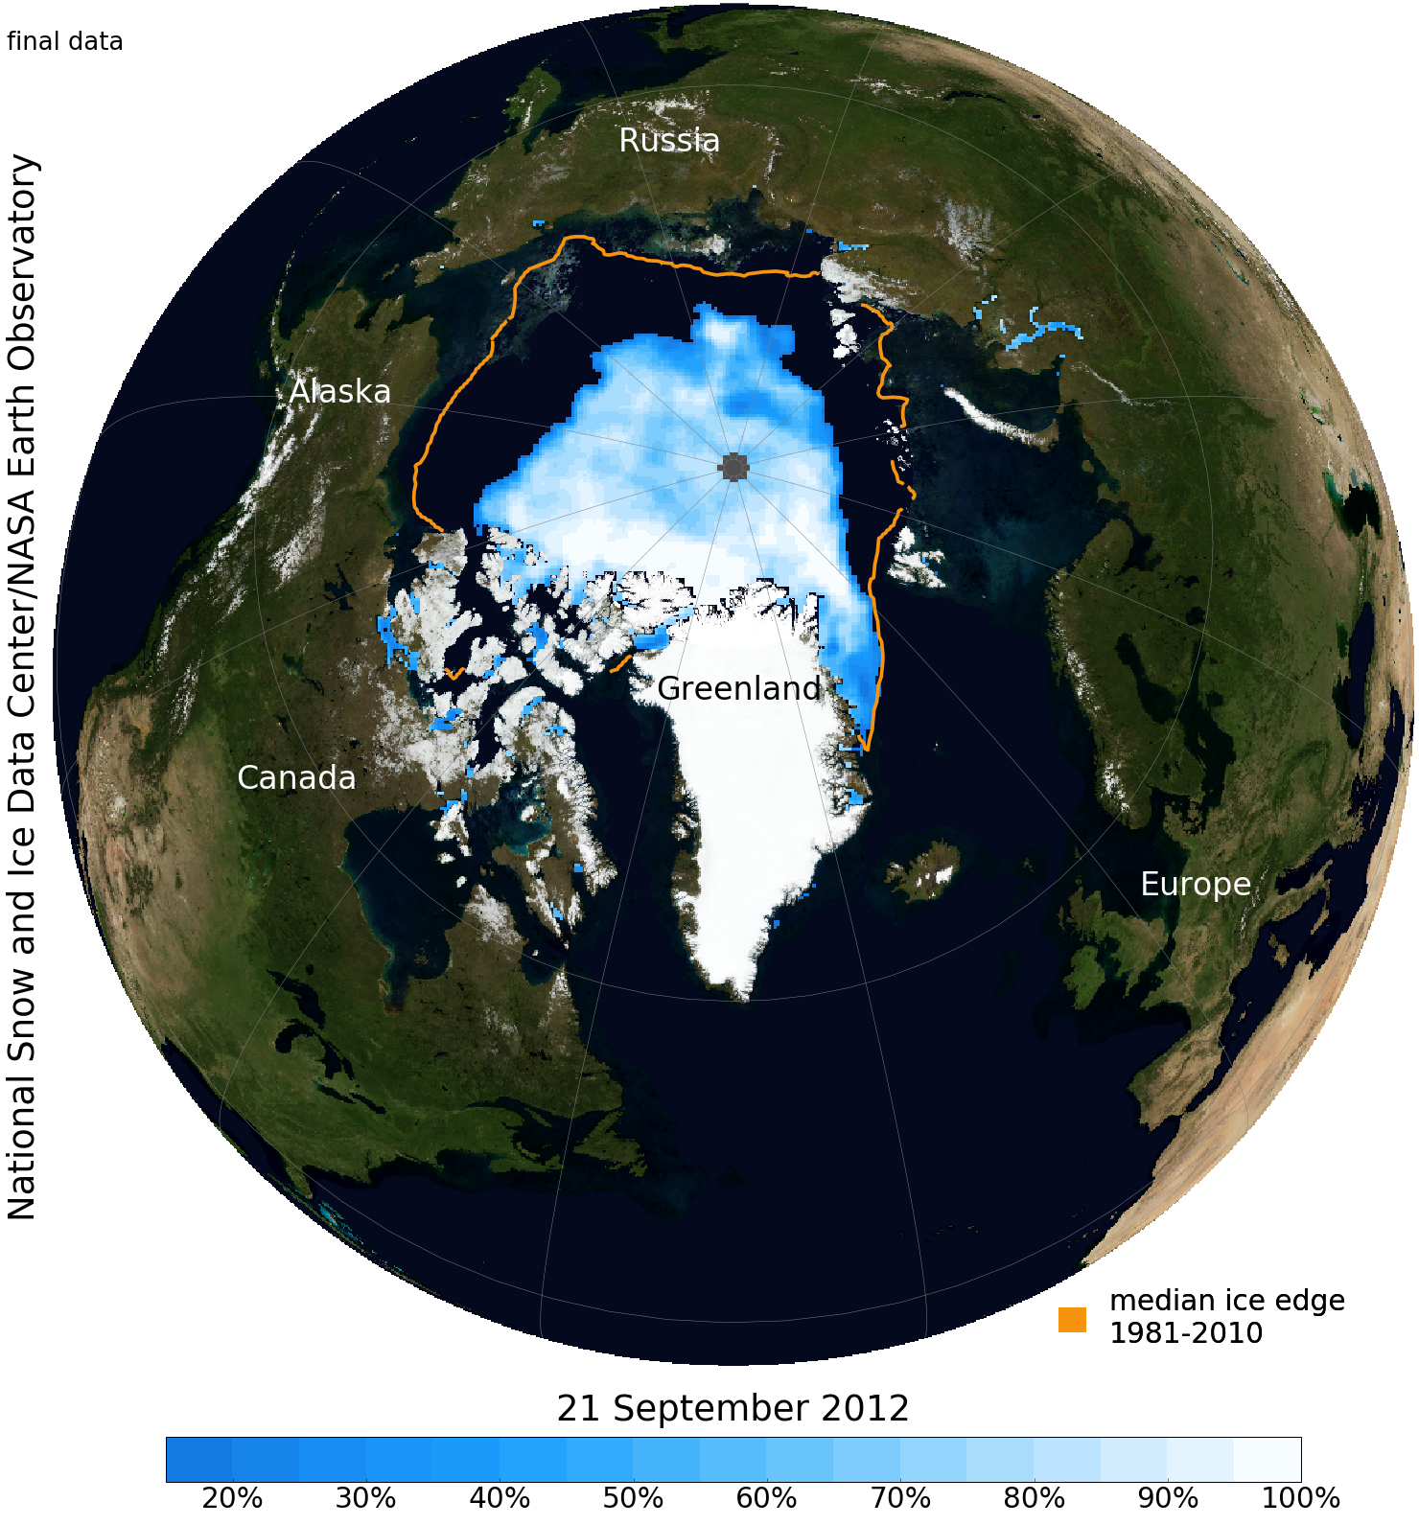
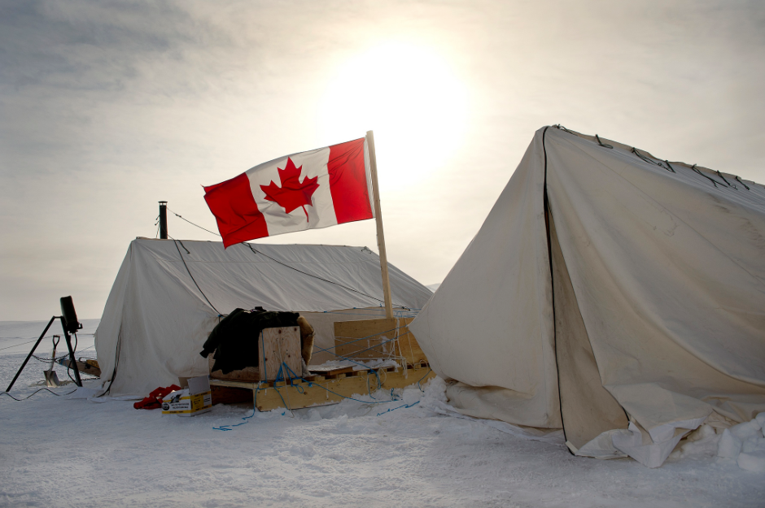
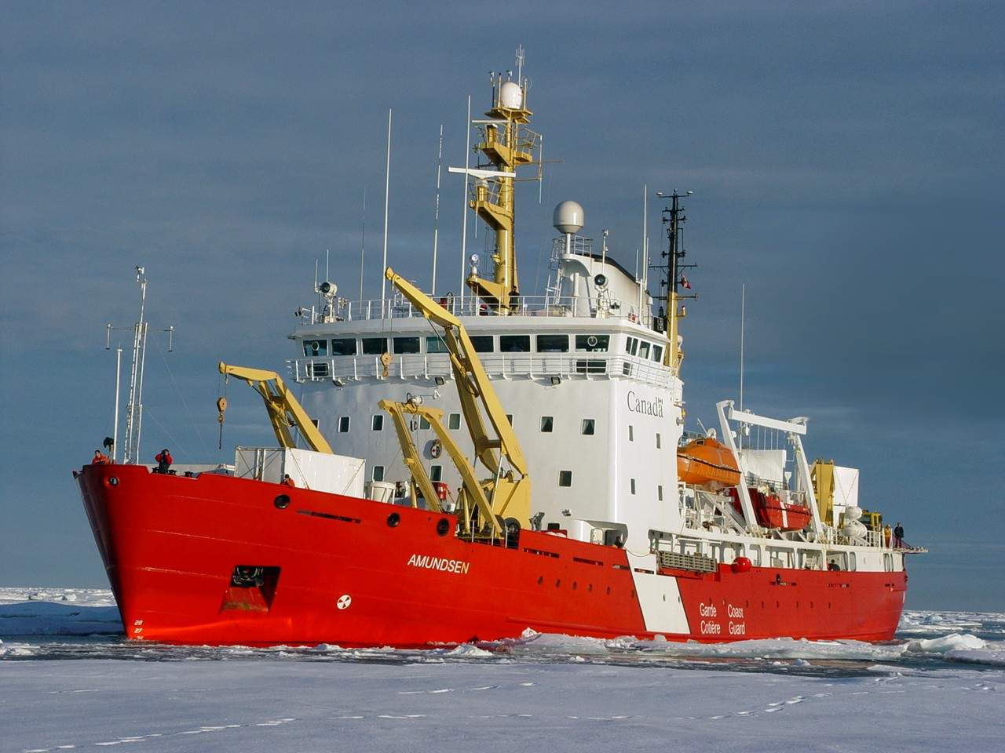
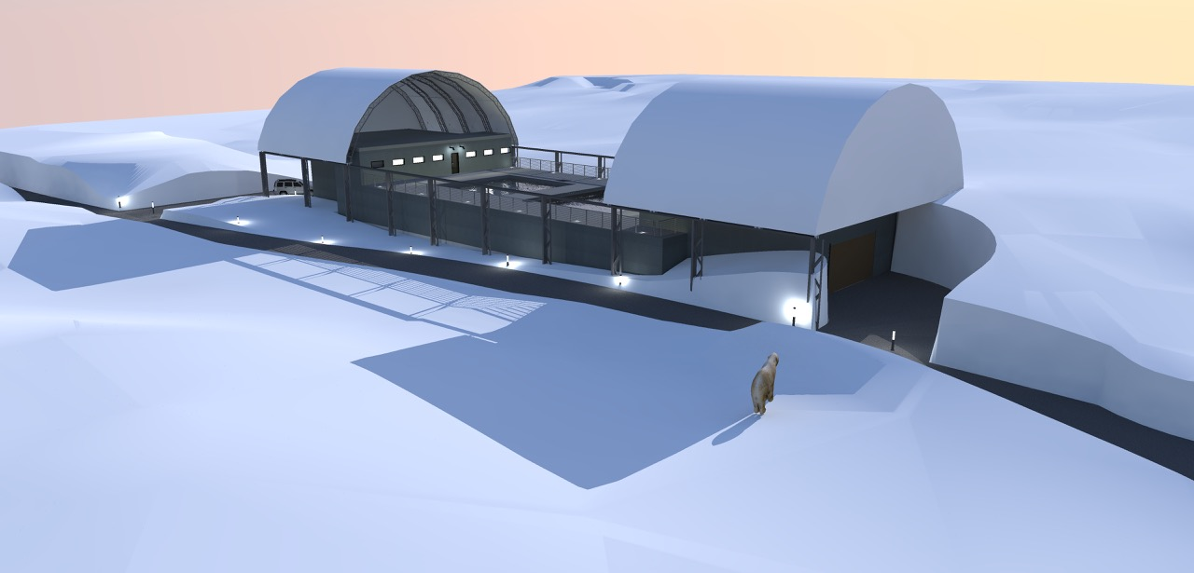

Slide 3
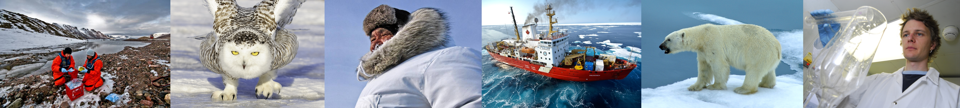

Tenure Track Faculty (20)
Research Faculty (8)
Adjunct/Affiliate Faculty (16)
Barber, David (CRC)
Rysgaard, Soeren (CERC)
Wang, Feiyue (CRC)
Ali, Genevieve
Stern, Gary
Milne, Brooke
Puyan Mojabi
Mundy, C.J.
Kuzyk, Zou Zou
Ehn, Jens. E.
Hanesiak, John
Papakyriakou, Tim
Halden, Norman
Iacozza, John
Hansen, Mark
Isleifson, Dustin
4 CRC – T2
2 assistant profs
2 new senior chairs
Dmitrenko, Igor
Kirilov, Sergei
Galley, Ryan
Lui, George
Lukovich, Jennifer
McCullough, Greg
Ogi, Masayo
Pucko, Monika
Loseto, Lisa - DFO
Michel, Christine - DFO
Stadnyk, Tricia – UM - Eng
Lobb, David – UM Agriculture
Shafai, Lot – UM Eng
Sydor, Kevin – MB Hydro
Ng, Adolf – UM - Business
Tremblay, Jean-Eric - ULaval
Yackel, John - UCalgary
Deming, Jody - UWashington
Macdonald, Robbie - DFO
Fortier, Louis - ULaval
Ferguson, Steve - DFO
Hubert, Casey - UCalgary
Miller, Lisa - DFO
Gosselin, Michel – UQAR
Stephen Petersen - APZ
28 Faculty
16 Adjunct/Affiliate
30 MSc, 30 PhD, 12 RA, 8 PDF, 16 staff
= 135
*14 new technical staff*

Slide 4
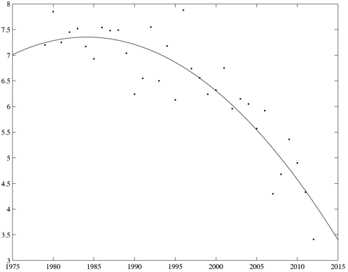
Sea Ice Summer Minimum
Sea ice Area (million km²)
f(x) = -0.0041411 *yr²+ 16.43*yr -16295
R² = 0.78
Year
Barber et al. 2016

Slide 5
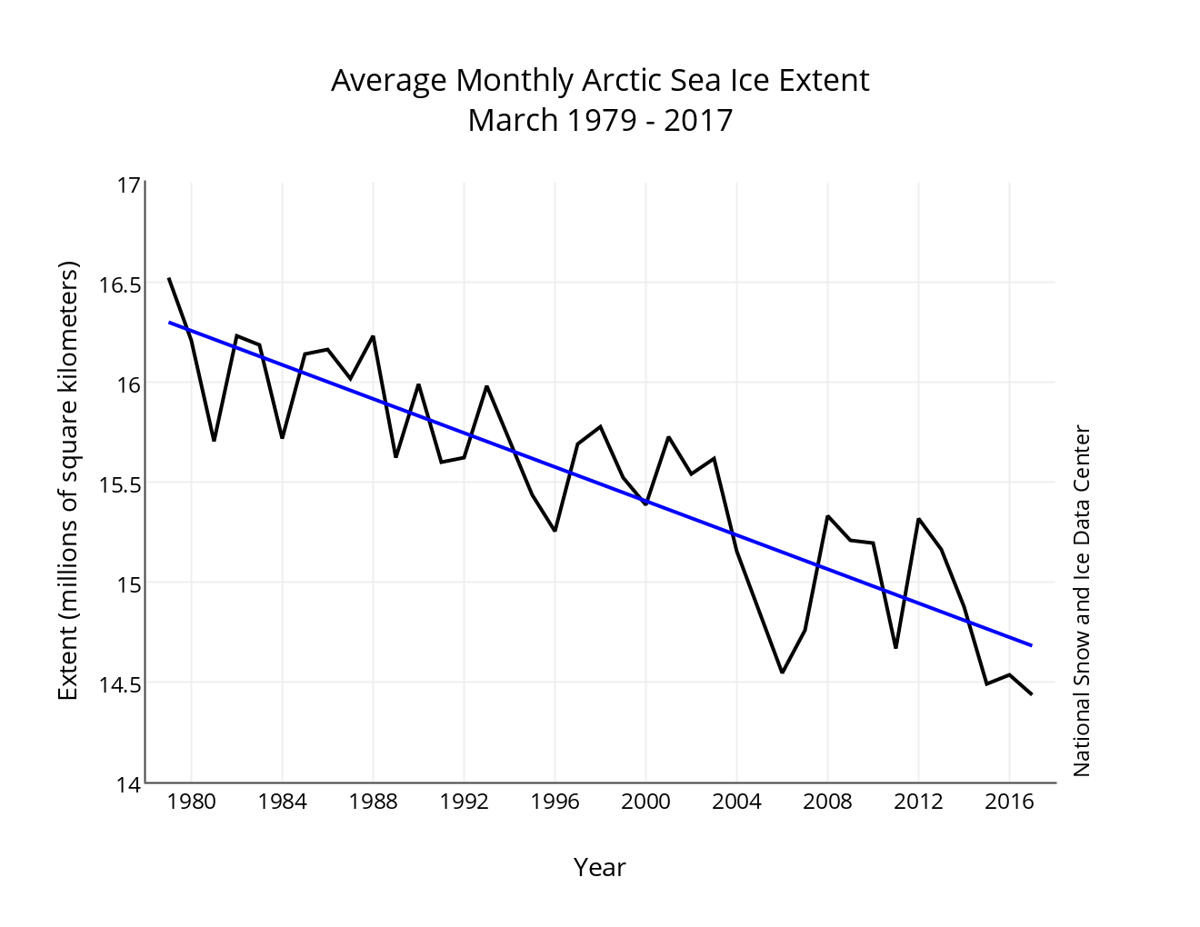
Sea Ice Winter Maximum
Barber et al. 2016

Slide 6



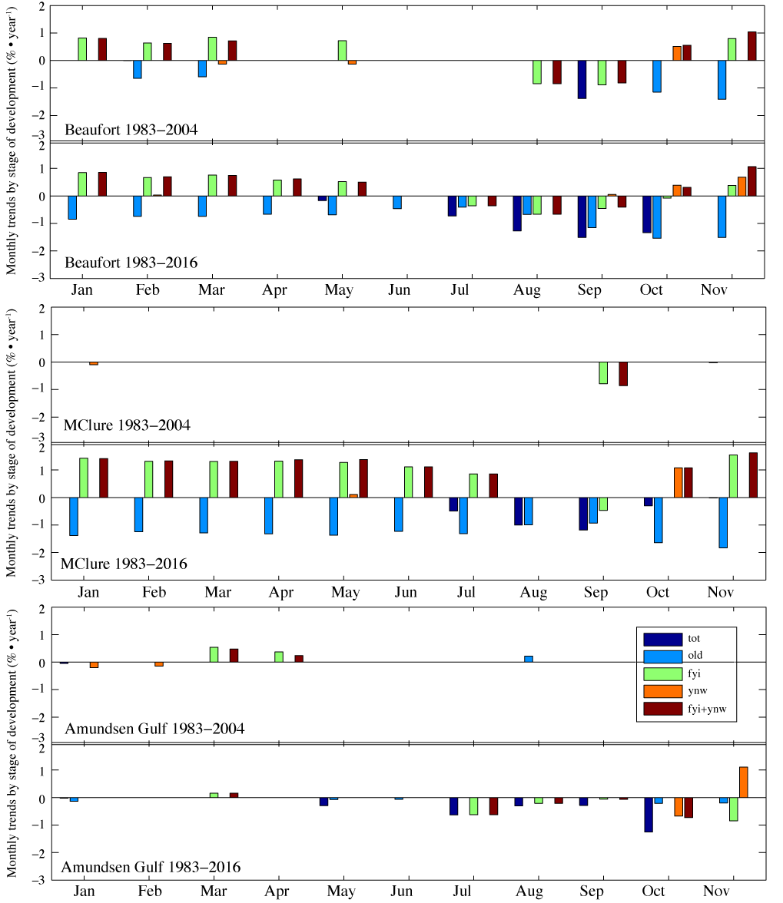
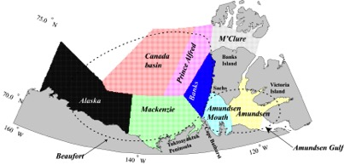
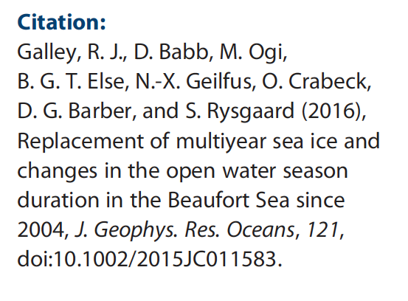
Beaufort Sea regional monthly mean [sea ice] trends
Figure: Trends (% yr⁻¹) in monthly mean sea ice concentration by stage of development in the Beaufort, M’Clure, and Amundsen Gulf regions from 1983-2004 and from 1983-2016. Trend data only presented where p < 0.10.
Notes:
BEAUFORT:
OLD ice being replaced by FYI over the winter
TOTAL ice loss in July – Oct due to OLD and FYI losses
YNW and FYI+YNW gains in Oct and Nov signaling delayed freeze up.
M’CLURE:
OLD ICE losses offset by FYI gains from Jan to Jul
TOTAL ice loss Jul to Oct due mostly to OLD ice losses
OLD ice loss in fall offset by FYI and YNW gains in Oct and Nov signaling delayed freeze up.
AMUNDSEN GULF:
Autumn sea ice is changing, TOTAL sea ice loss in Aug-Nov mostly the result of FYI an YNW ice losses in those months
Massive increase in YNW in Nov indicating delayed freeze up.

Slide 7
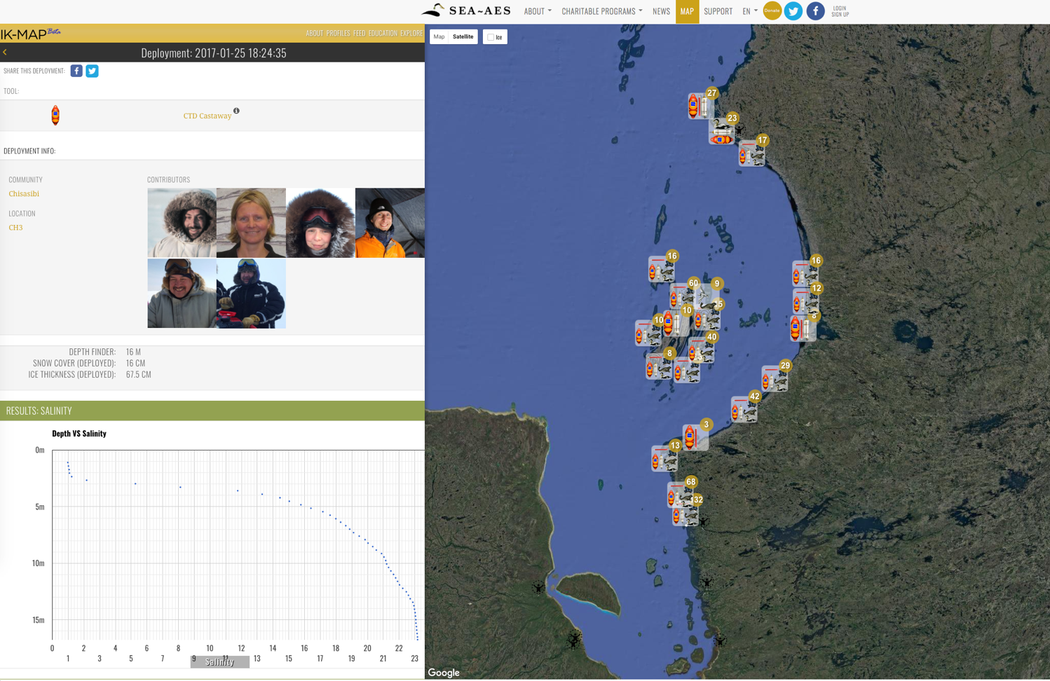
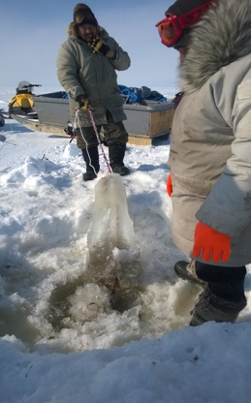
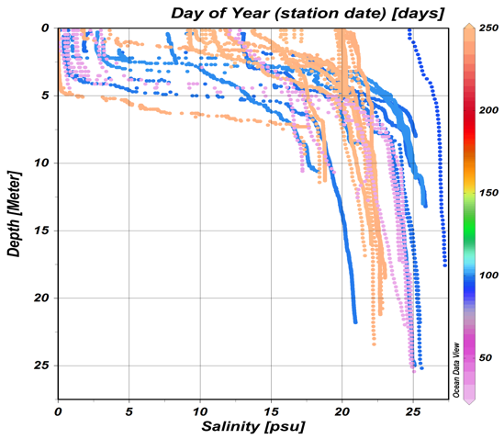
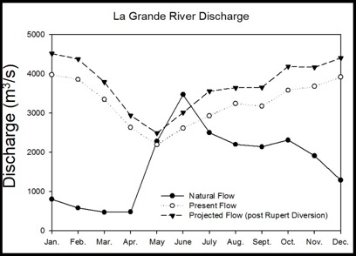
Community-Based Research in Southeast Hudson Bay and James Bay
IK-MAP & SIKU:
The Inuit Knowledge Wiki & Social Mapping Platform
Community-driven research: Addressing concerns on changes in local environment
January
April
August
Seasonality of La Grande River plume

Slide 8
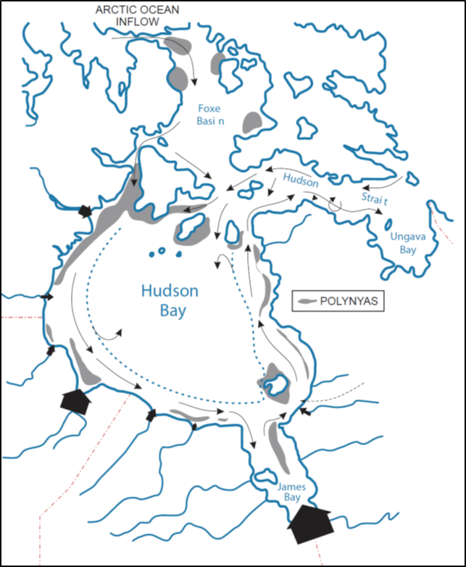
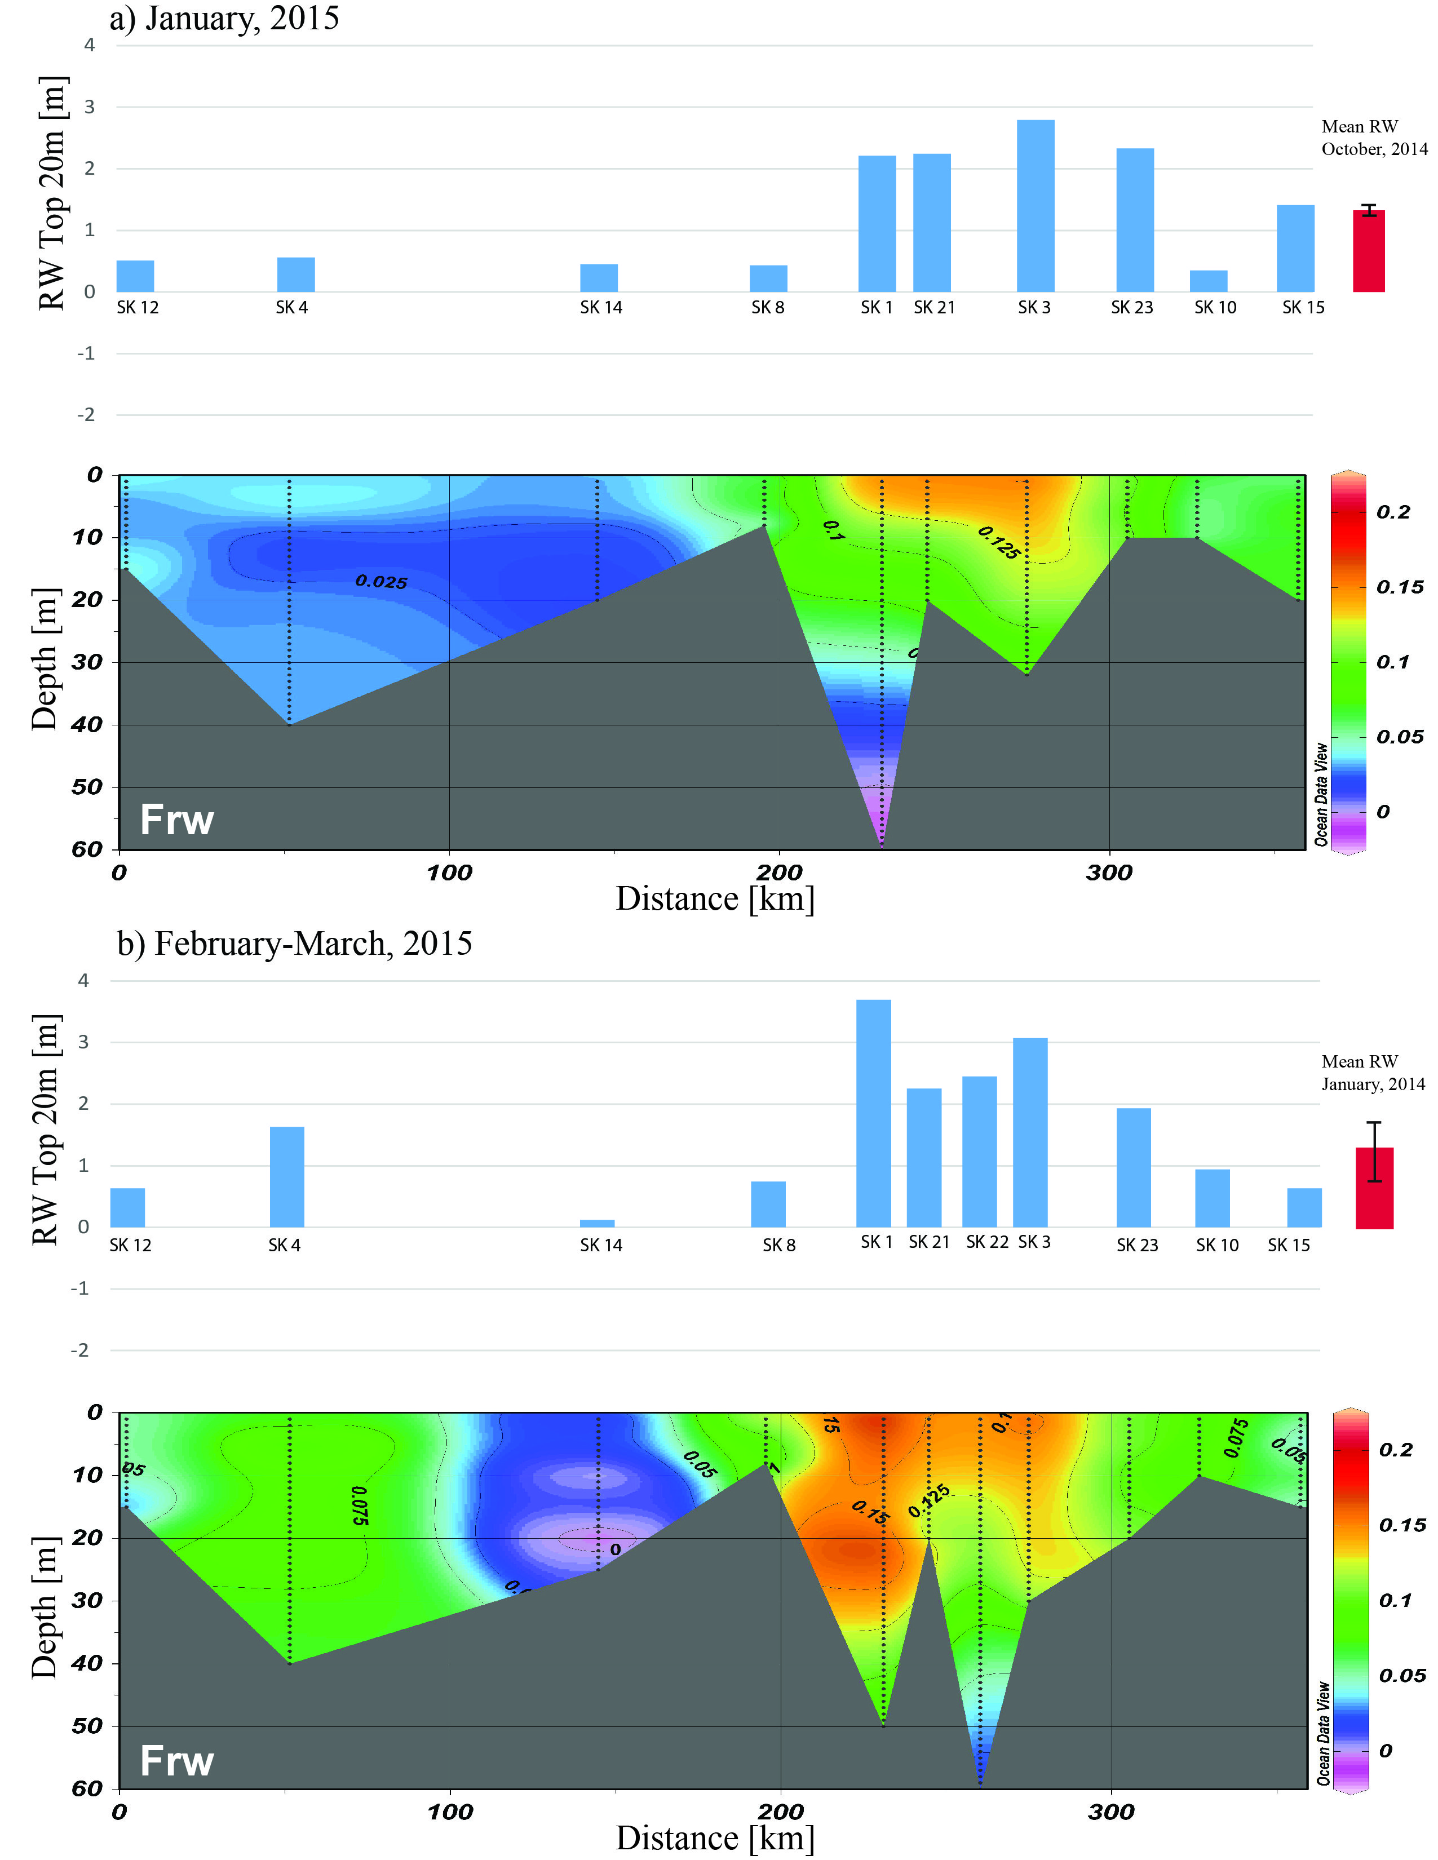
Winter Freshwater-Marine Coupling in
Southeast Hudson Bay
First observations of freshwater sources (S, δ¹⁸O) and spatio-temporal distribution surrounding the Belcher Islands in winter
Community-based project with Inuit from Sanikiluaq, Nunavut
A major finding was that a lobe of freshwater, mainly river runoff, remained SE of the Belchers throughout winter
  Far from any river mouth
  Out of cadence with low winter river discharge of unregulated river systems
Maintained stratified water column in area, as opposed to deep winter mixing typical in other parts of Hudson Bay
Investigations of biogeochemical implications and impacts on local sea ice are next step
Polynya-generated water
Fraction of river water (Frw) in the water column in February-March, 2015 .Above the sections, bars show the RW inventory in the top 20m of the water column.
La Grande R.
Papers in review and/or preparation: Petrusevich et al. (in review) (submitted to Continental Shelf Research, Dec 2017); Eastwood et al., (in prep.)

Slide 9
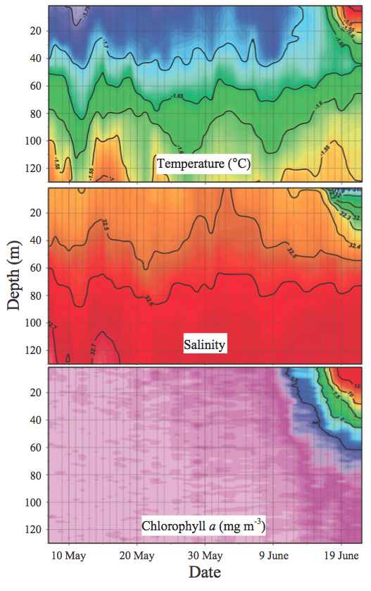
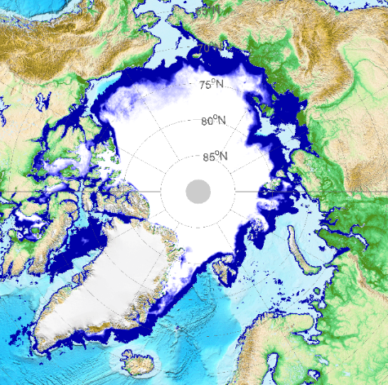
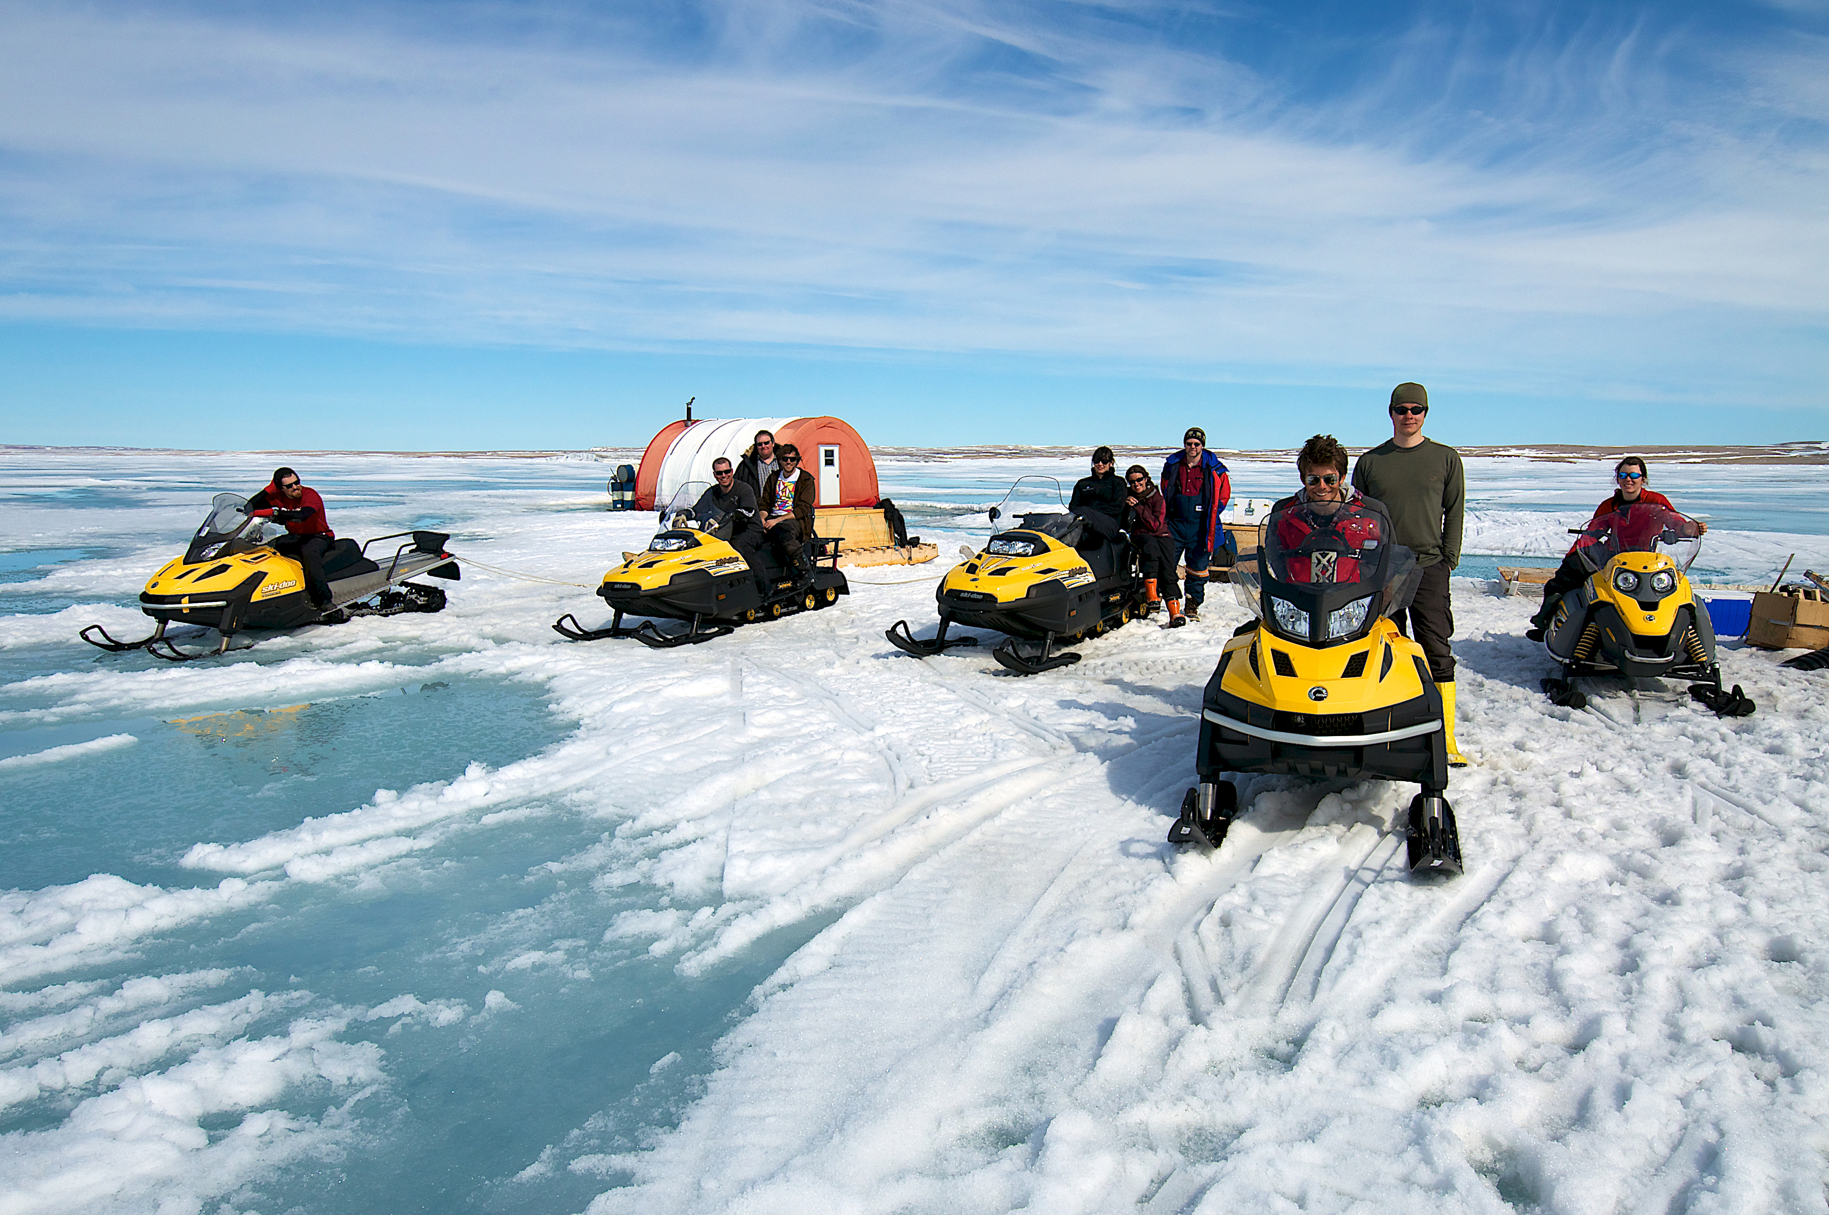
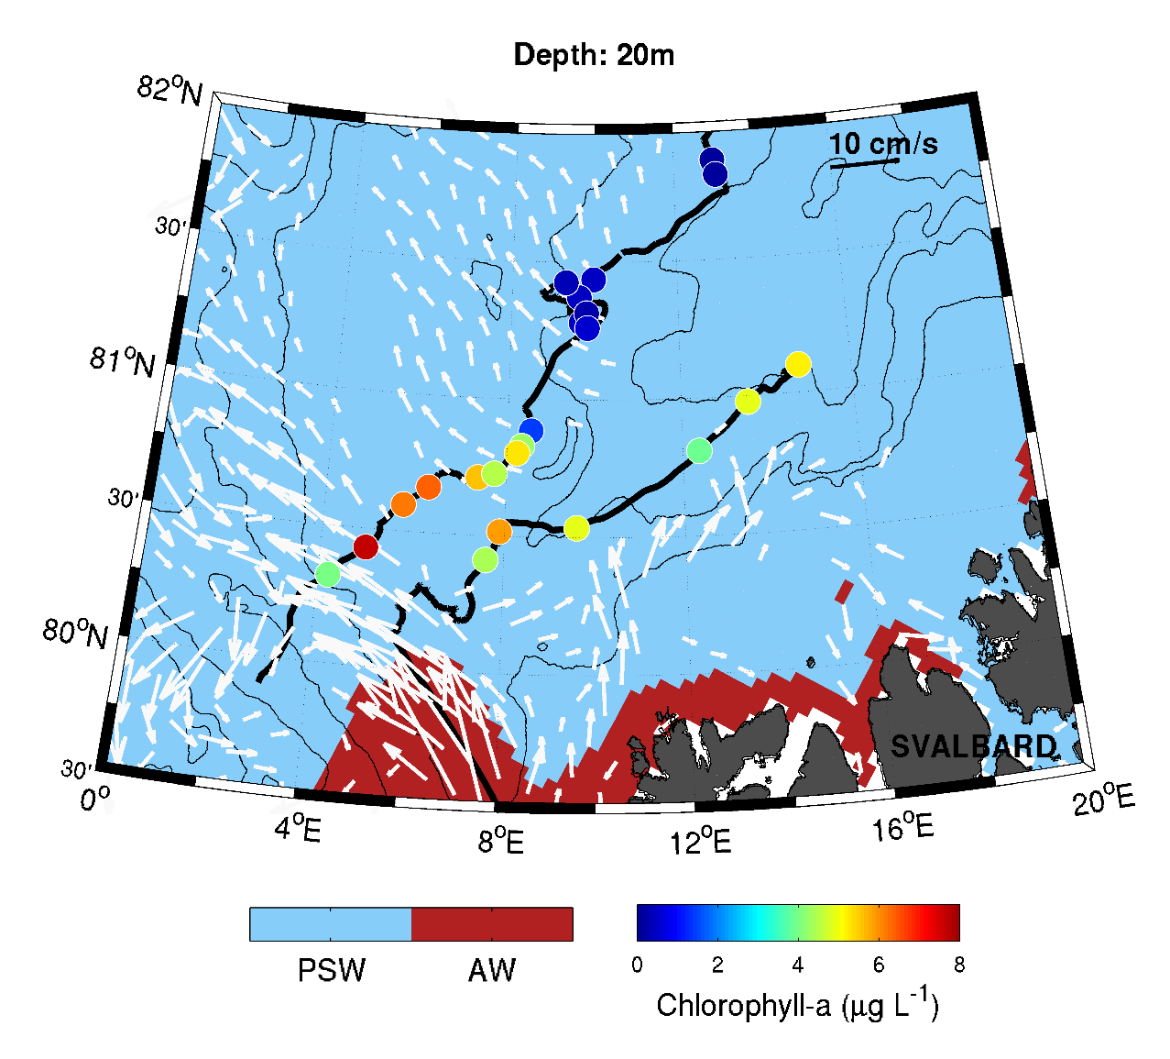
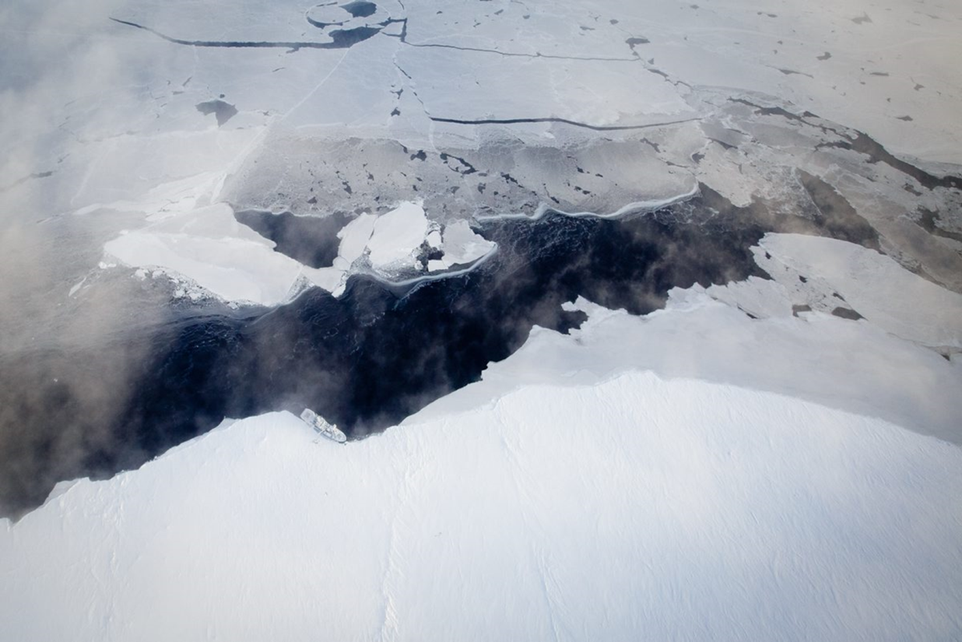

Under-ice phytoplankton blooms
Re-invigorated by Mundy et al. (2009, GRL), under-ice phytoplankton bloom investigations have helped fuel major scientific expeditions (e.g., NASA-ICESCAPE, NPI-N-ICE, NERC-CAO)
Mundy et al. (2014) showed bloom development was linked to melt onset (direct linkage to climate change),
Galindo et al. (2014) then demonstrated that the rate of melt progression can influence bloom composition by centric (slow melt) versus pennate diatoms (rapid melt)
Assmy et al. (2017) documented lead formation in a thinner, more dynamic ice cover can also support bloom development prior to ice melt, while supporting development of a non-diatom algae, namely Phaeocystis
Melt season
June 2010, 2011
Mundy et al. 2014 MEPS
Galindo et al. 2014 J. Geophys. Res.
Pre-melt season
Meereisportal.de
May 2015
Assmy et al. 2017 Scientific Reports

Slide 10
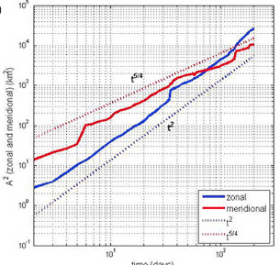
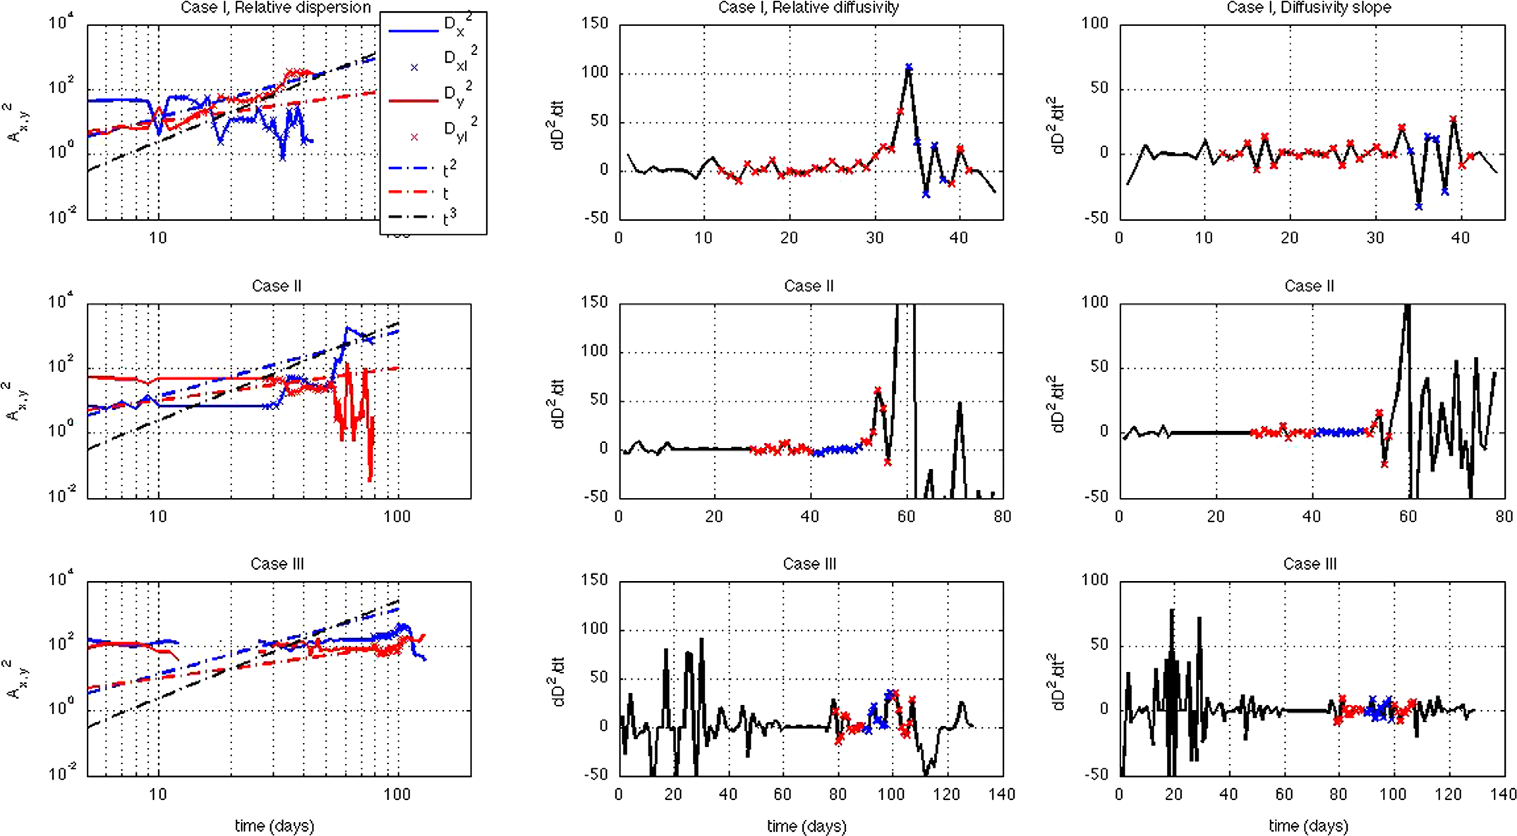
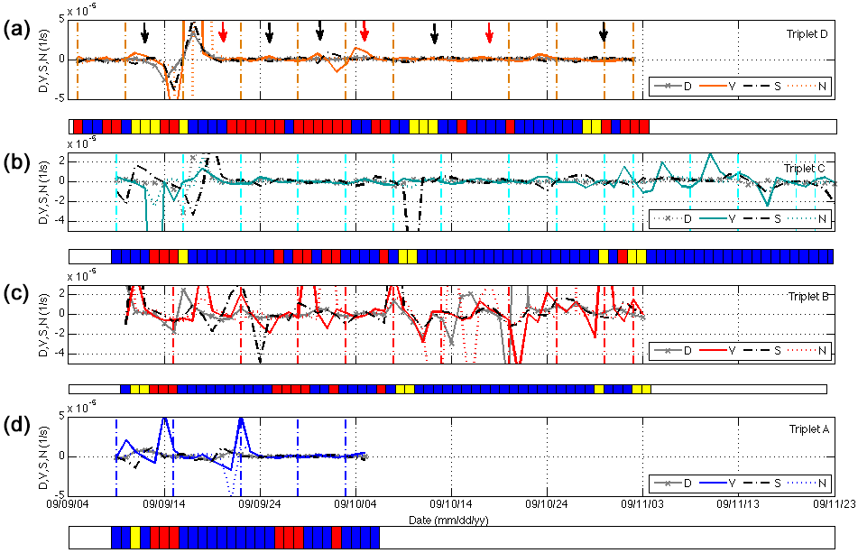
Sea Ice Motion modelling – Statistical dynamics (Lukovich)
Zonal and meridional absolute dispersion
Zonal and meridional relative dispersion and diffusivities
Temporal scaling maps
Differential kinematic parameters
Notes:
Single-particle dispersion and Lagrangian integral timescales. Distinctive scaling laws in the zonal and meridional directions based on single-particle statistical analysis in the seasonal ice zone.
Two-particle dispersion and eddy diffusivities; distinct scaling laws in the zonal and meridional direction for loop and meander reversal events.
Temporal scaling maps to identify distinction dynamical regimes.
Three particle statistics to quantify sea ice deformation.
Lukovich et al. (2011; 2014; 2015; 2017)

Slide 11
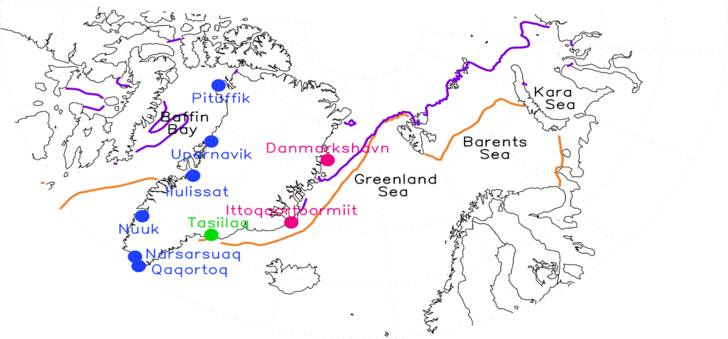
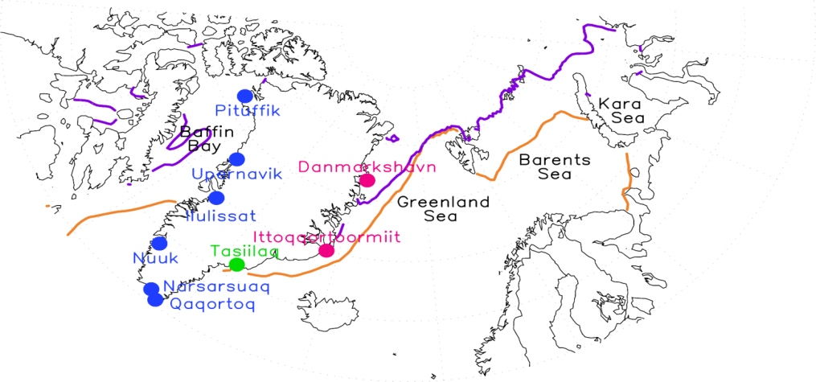
Arctic – low latitude climate coupling (Ogi et al.)
Using Greenland station temperatures (GrSTs) from coastal Greenland and sea ice extent (SIE) in the marginal seas surrounding Greenland (Baffin Bay, Greenland Sea and Kara-Barents Sea) we look at the relationship between these variables and the atmospheric circulation patterns that foster these relationships.
Winter
Summer
NAO
L
Summer AO
The winter GrSTs and SIEs in the west side of Greenland are associated with the winter NAO.
The winter GrSTs and SIEs in the east side of Greenland are characterised by cyclonic circulation over the Greenland Sea and Barents Sea.
The summer AO influences the summer GrSTs and SIEs.
Ogi, M., S. Rysgaard, D.G. Barber (2016) Tellus A, 68, 31971

Slide 12
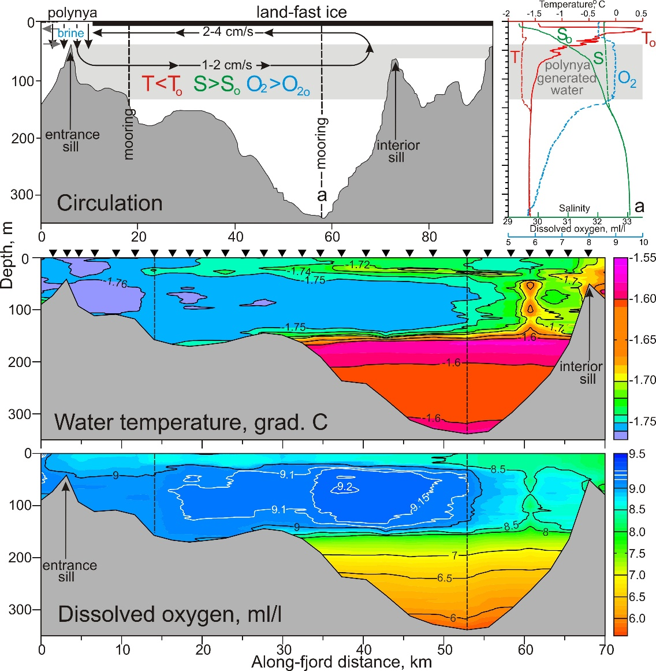
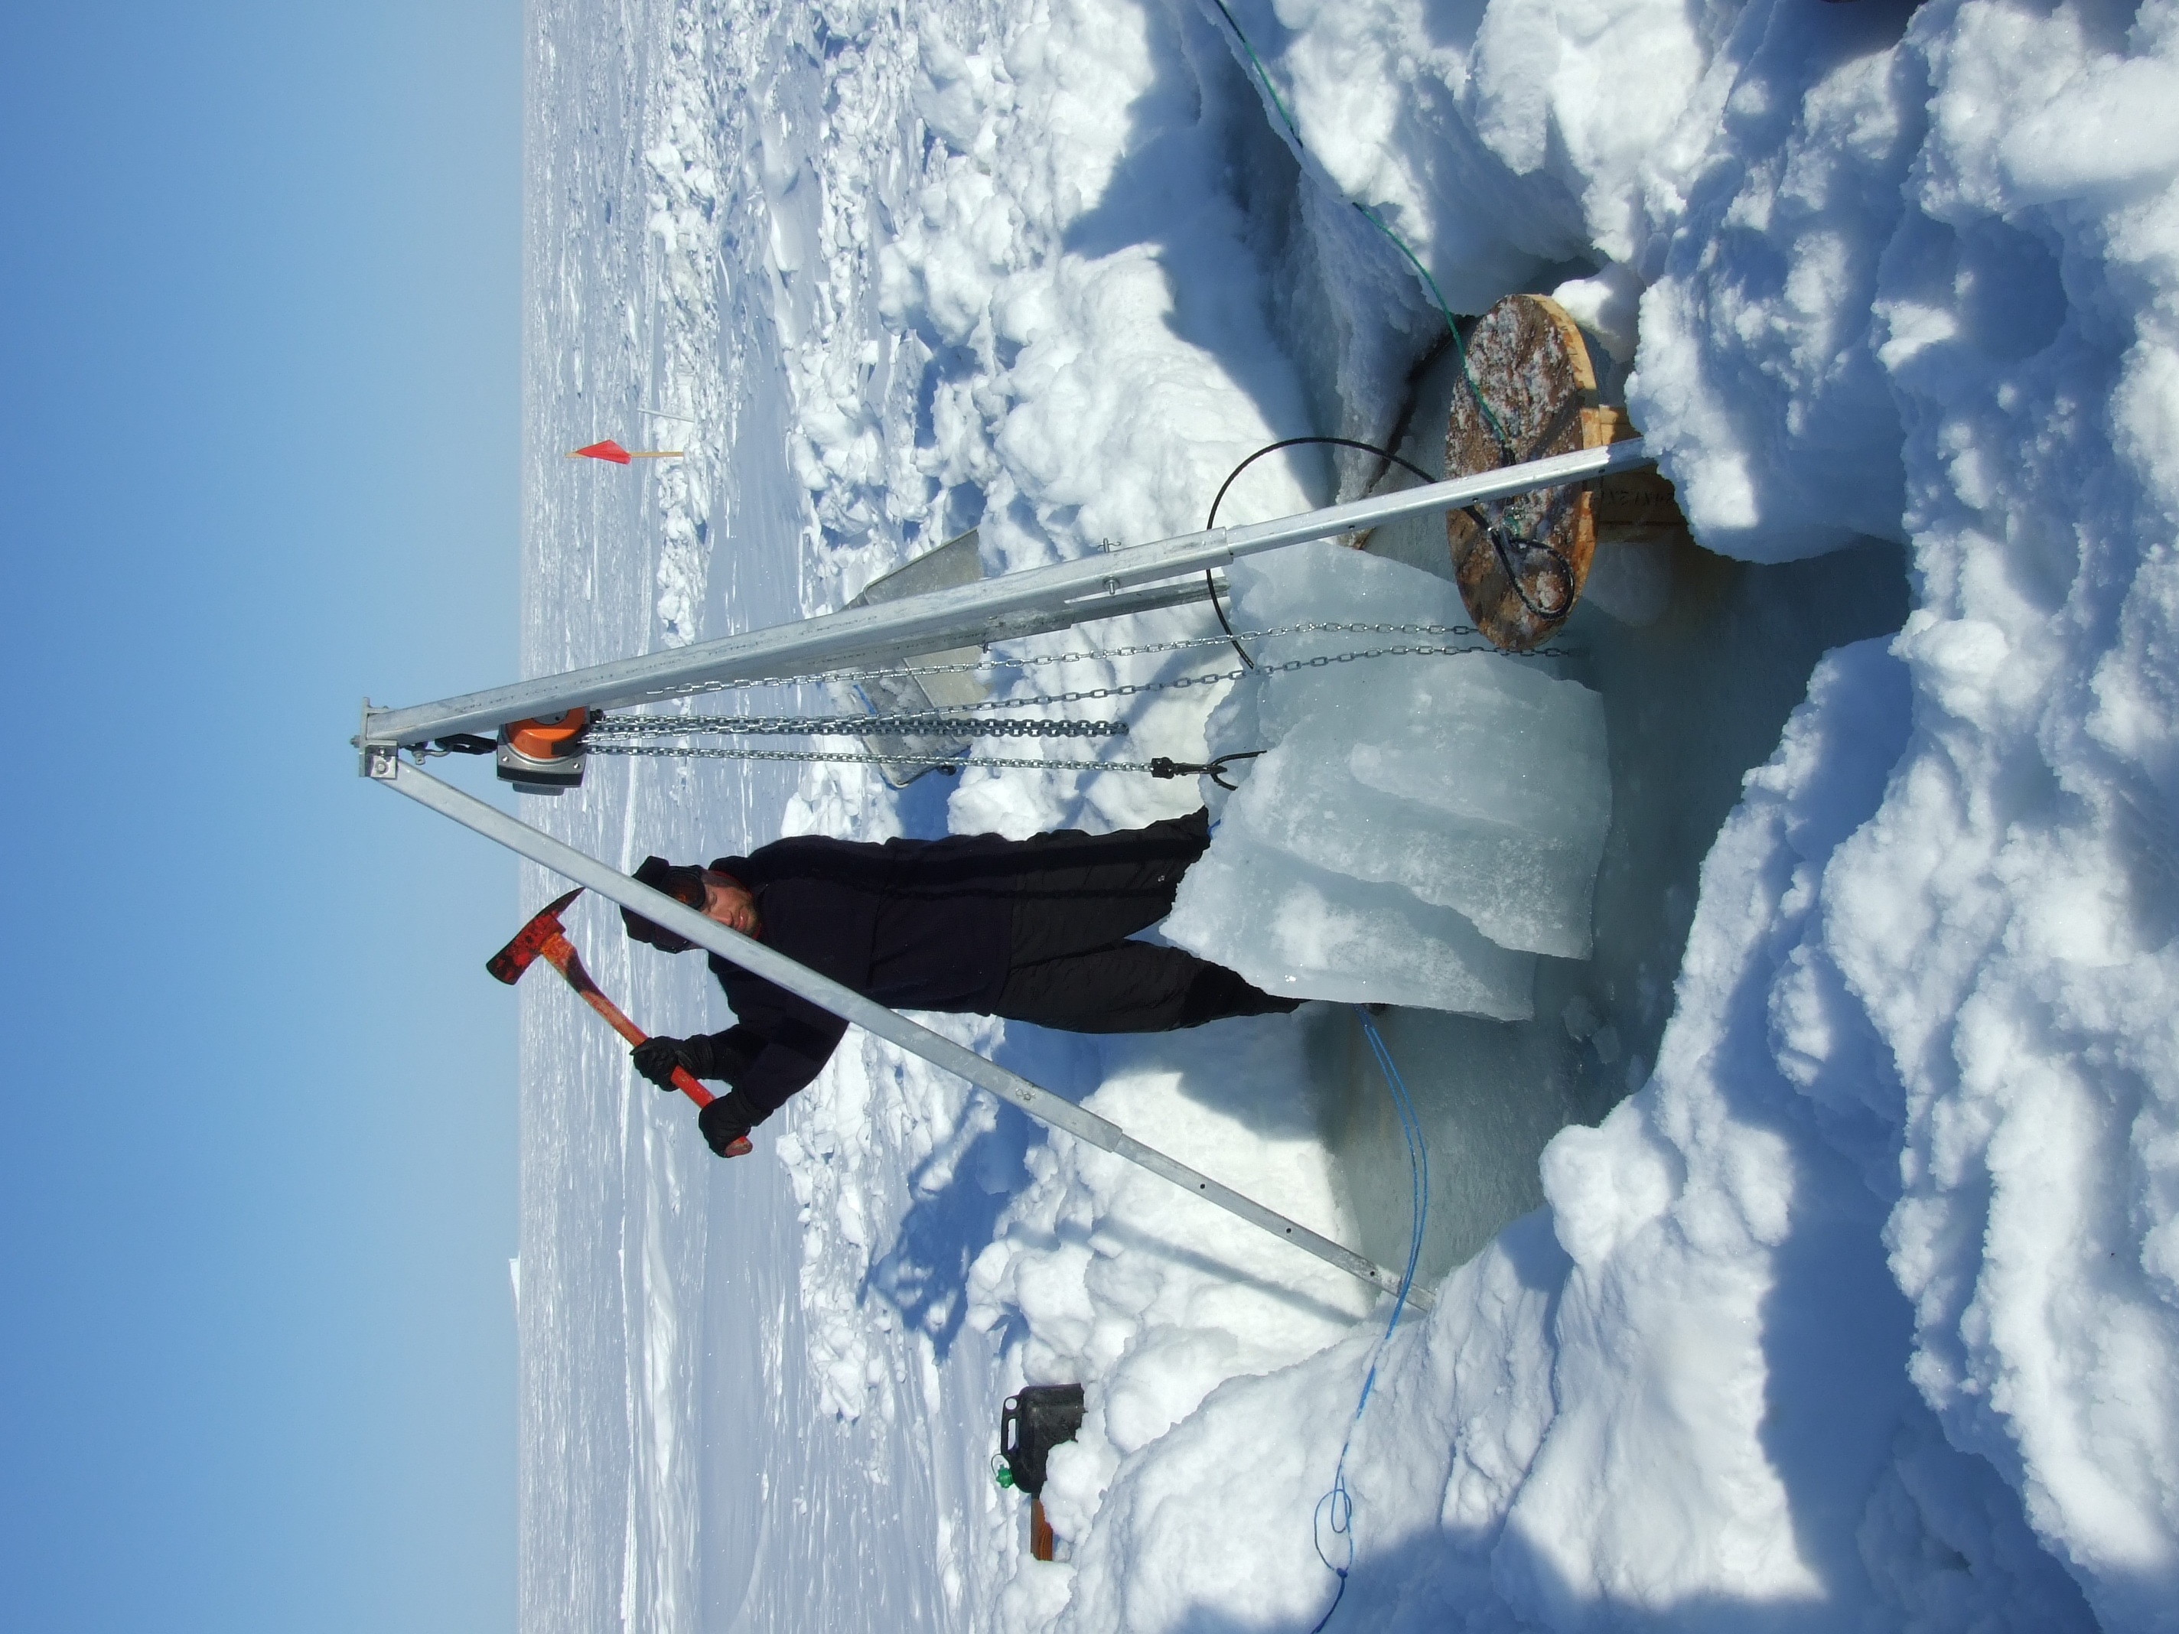
Polynya-induced circulation in Greenland fjord Young Sound (YS), 2013-14
In this CERC study we show that the polynya, created by wind forcing over the mouth of the YS facilitates water circulation in the landfast ice-covered fjord. Polynya openings’ (i) strongly impact the fjord water dynamics ventilating the fjord (Dmitrenko et al., 2015), (ii) intensify the ocean-to-ice heat flux (Kirillov et al., 2015), (iii) favours the ocean-fjord exchange (Bonne et al., 2017) and (iv) result in serious consequences for biological activity disrupting regular behavior of zoo-plankton (Petrusevich et al., 2016).
Polynya-generated water
Mooring recovery in YS, May 2014
Credits: I. Dmitrenko

Slide 13
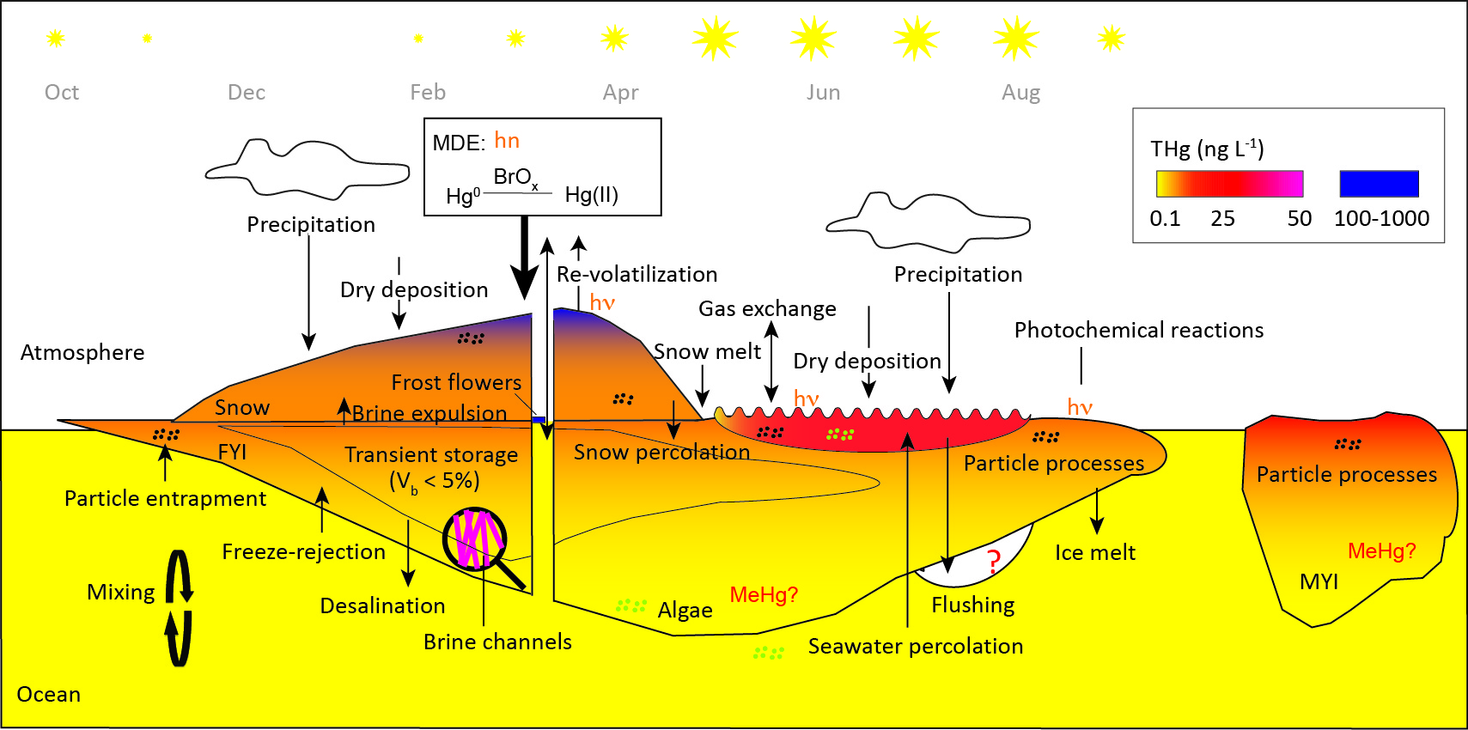
F. Wang (CRC in Arctic Environmental Chemistry):
Mercury transport and methylation in Arctic sea ice
Chaulk et al., 2011
Beattie et al., 2014
Wang et al., 2017
FYI
MYI
Sea ice acts as both a transporter (in space and in time) and a reactor for mercury cycling across the atmosphere-ocean interface, affecting mercury uptake in the Arctic marine ecosystems

Slide 14
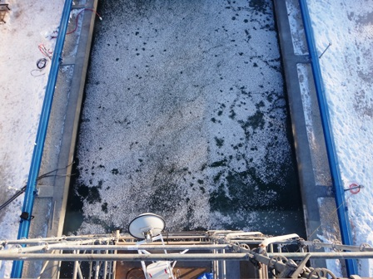
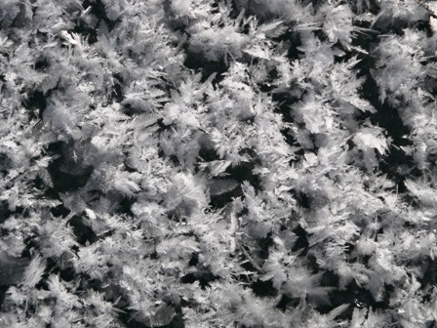
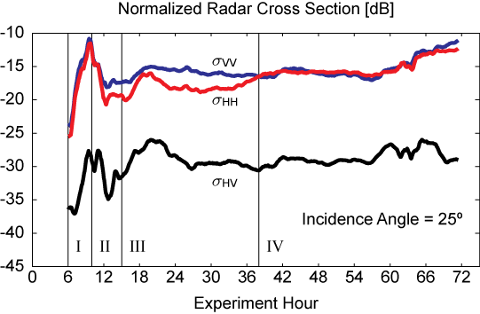
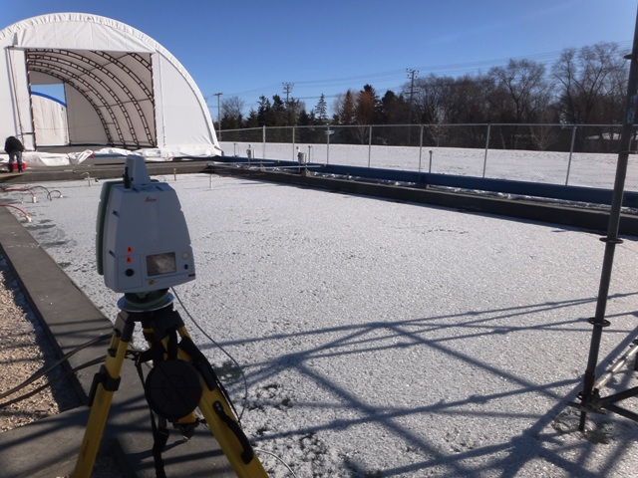
Microwave Remote Sensing of Frost Flowers at the Sea-ice Environmental Research Facility (Isleifson et al.)

Slide 15
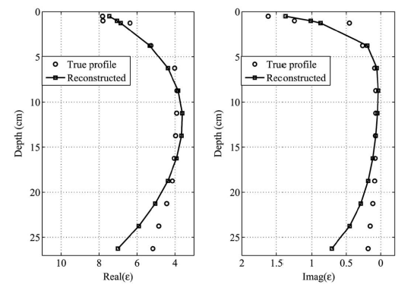
Incorporating prior information into electromagnetic inversion (Mojabi et al.)
The inversion process was improved by incorporating prior information into the algorithm; e.g., the expected C-Shape distribution of the sea ice dielectric profile and its surface roughness parameters were incorporated into the inversion algorithm.
Five incidence angles and
five frequencies at C-band
have been used
in a monostatic configuration.
N. Firoozy et. al., IEEE JSTARS, vol. 8, no. 5, 2015

Slide 16
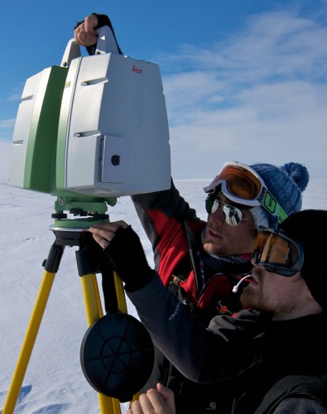
LIDAR and ice mass balance observations of melt pond evolution
Jack Landy, Jens Ehn, David Barber
LIDAR: normalized premelt
surface height distributions
Premelt surface topography
Rough surface
Flat surface
Temporal change along black line
Melt pond coverage
Observed and simulated relationships
LIDAR observation of sea ice topography in Resolute and Cambridge Bay (Nunavut) revealed importance of premelt roughness on pond fraction. Yet, melt water retention remained between 20-40 mm. Premelt surface roughness could thus be used to predict future melt pond fraction and albedo (Landy et al., 2015)
Pond surface above sea level
Landy et al., JGR, 2014
Landy et al., GRL, 2015

Slide 17
NSERC OSICA Network
Objective:
To generate scientific knowledge, develop effective technologies, and support decision-making for evidence-based policy to respond to oil spills in ice-covered Arctic waters.
Multidisciplinary:
Multi-sectoral:
Natural sciences
Engineering
Social sciences
Inuit Knowledge
Academia
Government
Industry
Northern Indigenous communities
$5.5M NSERC + ~$4.5M partners
over five years (2018–2023)

Slide 18
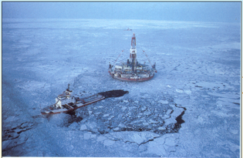


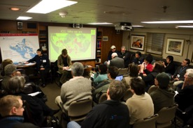
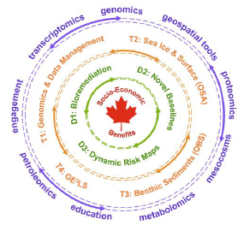
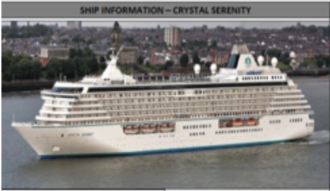
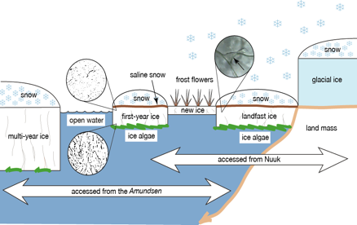
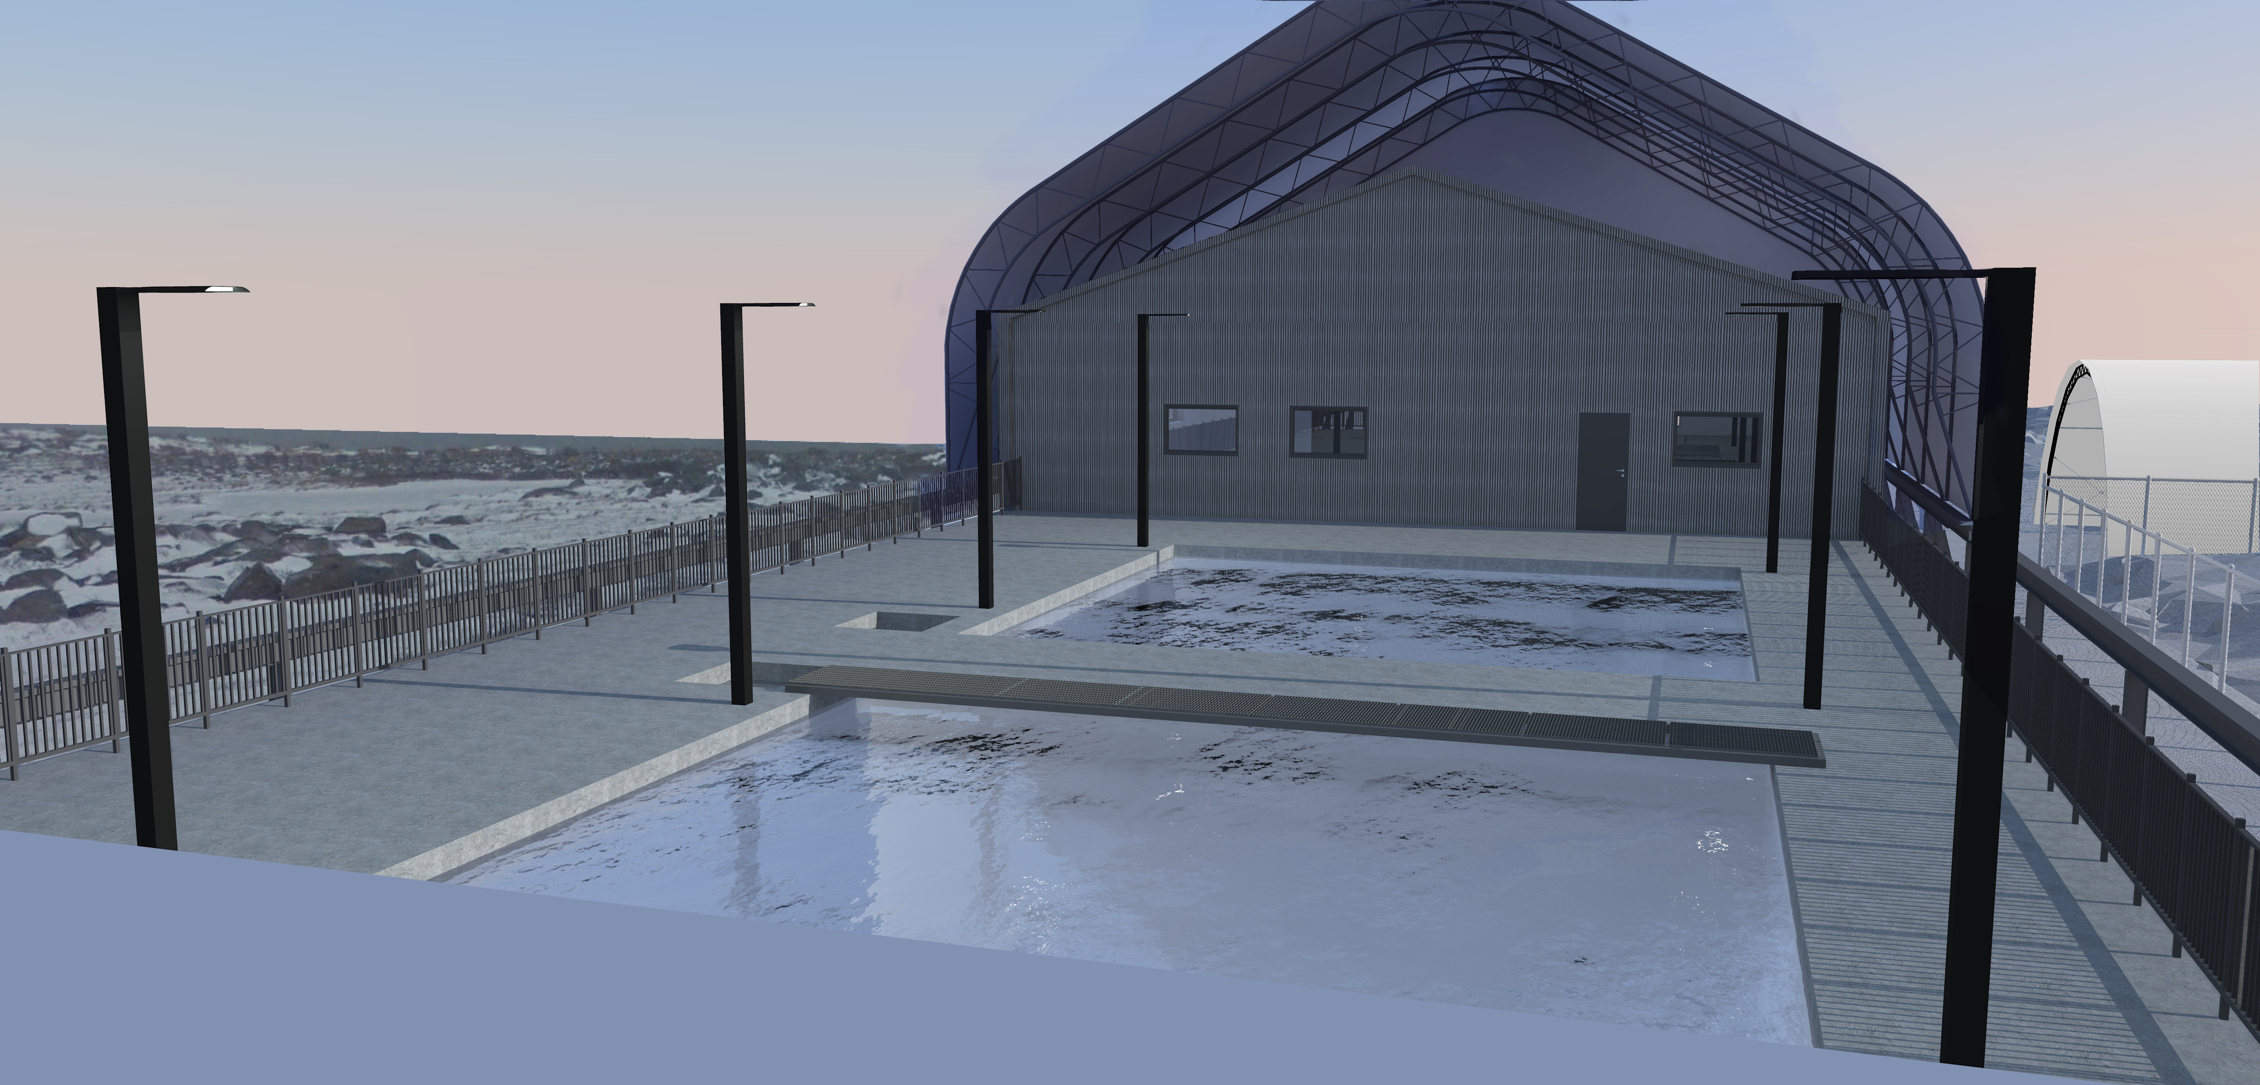
GENICE –bioremediation of oil spills in sea ice ($10.7 M – 4 yrs)
GE³LS
T/S-linked

Slide 19

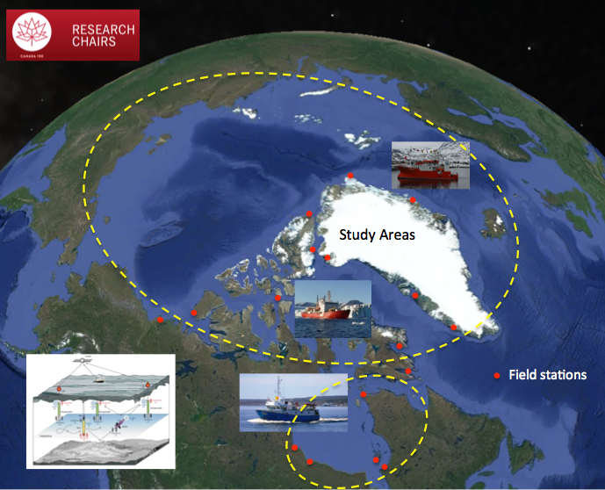
Looking Forward:
Dr. Julienne Stroeve
Seven year program
Cash - $18M; In Kind - $17.7M
Two new Tenure Track Faculty
Eight Technical, Admin and RA’s
12 new student positions
Successful in a new senior Canada 150 Chair in Sea Ice - Climate Coupling

Slide 20
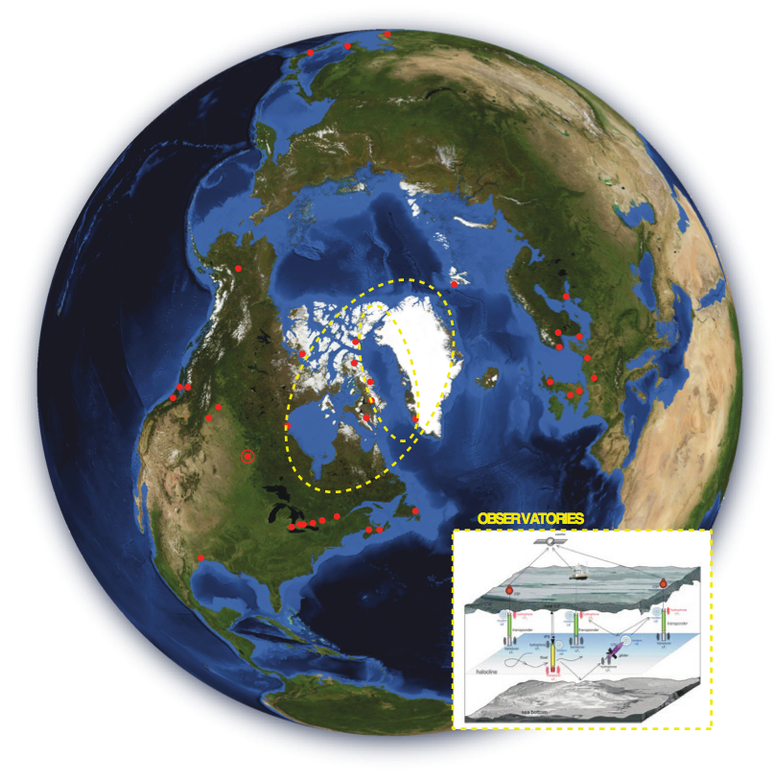
Looking Forward:
?
TBD
Seven year program
Cash - $38M; In Kind - $470M
Two new CRC tier-2
Twelve new Technical, Admin and RA positions
23 new student positions
Successful in a new Canada Excellence Research Chair in
Arctic Sea Ice, Freshwater-Marine coupling and Climate Change

Slide 21
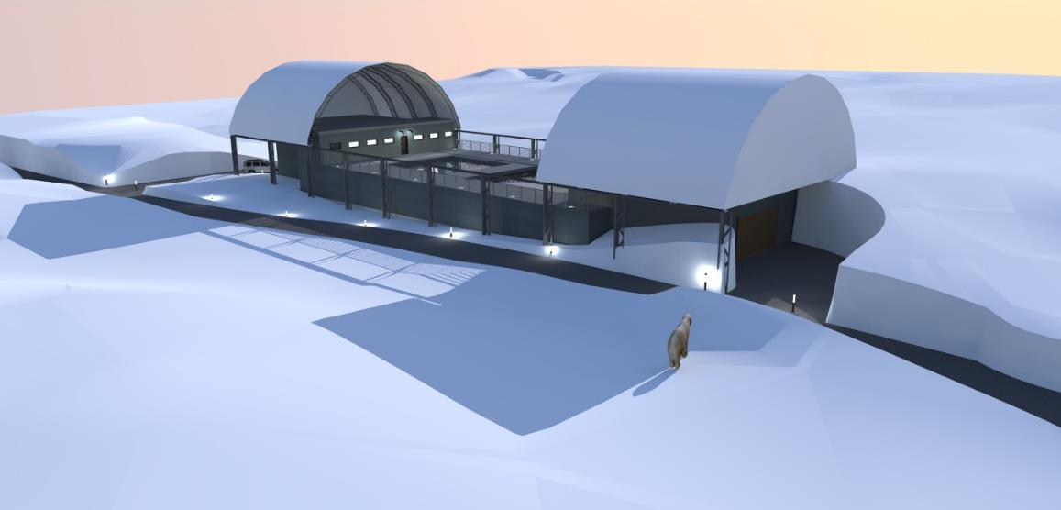
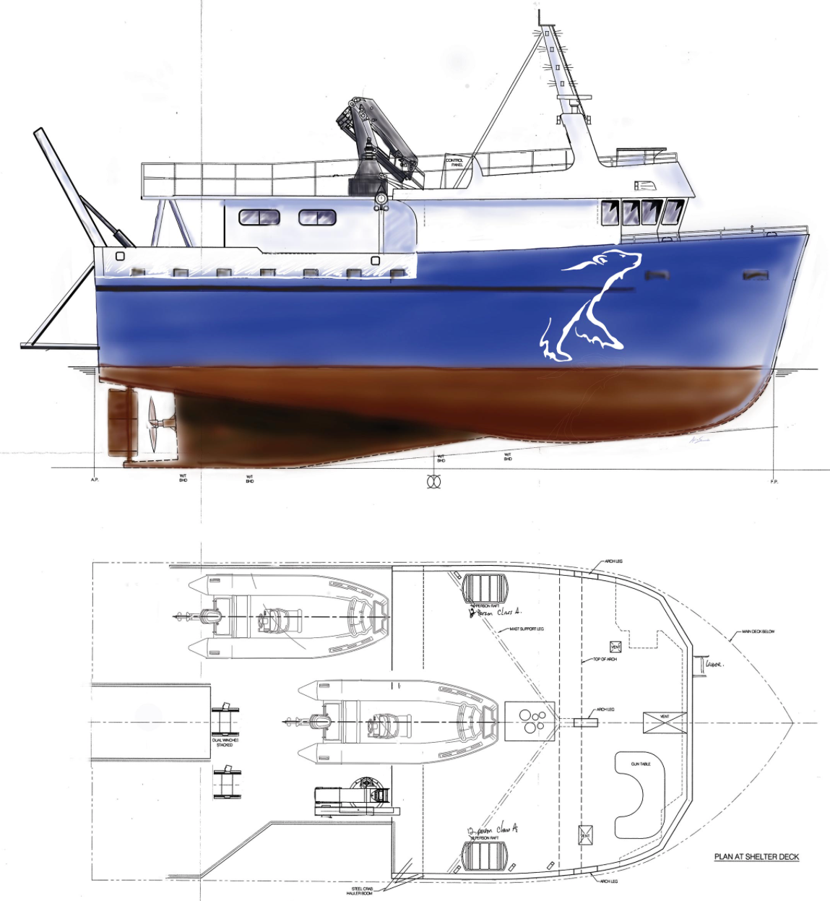
Looking Forward:
The Churchill Marine Observatory (CMO)
Thirty year program
Cash - $44M; In Kind - $27M
Two new CRC-T2 chairs
Nine new Technical, Admin and RA positions

