Slide 1
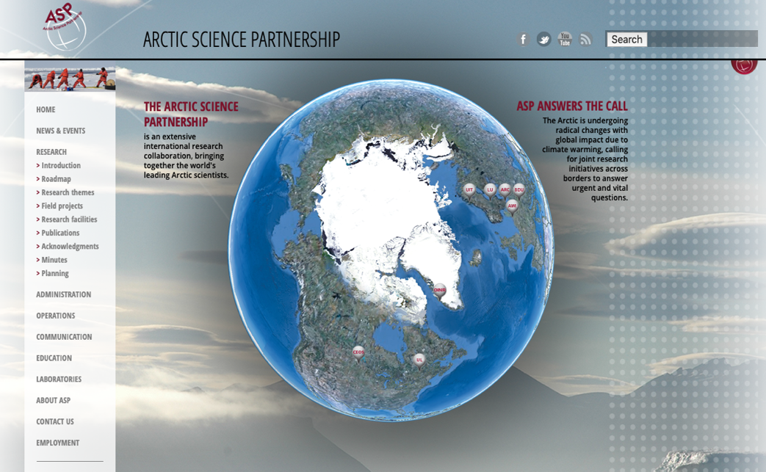
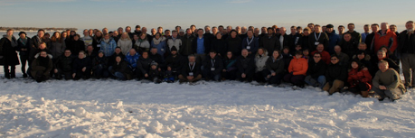
Arctic Science Partnership
https://www.asp-net.org
Gimli - Canada 2012

Slide 2
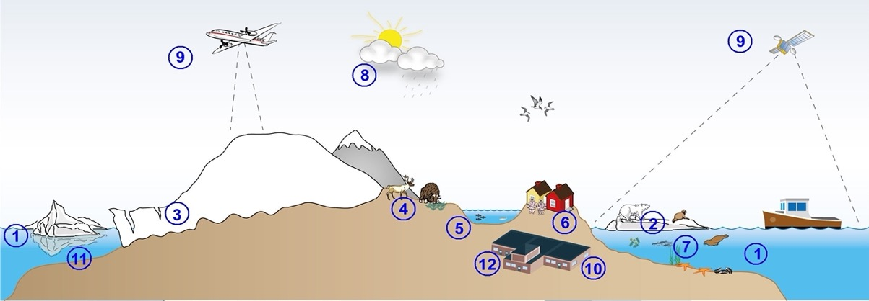

Slide 3
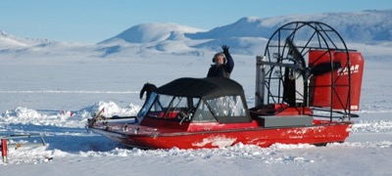
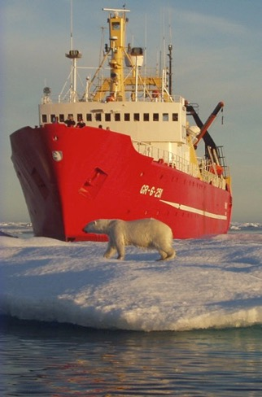
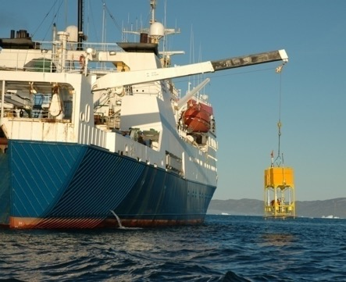
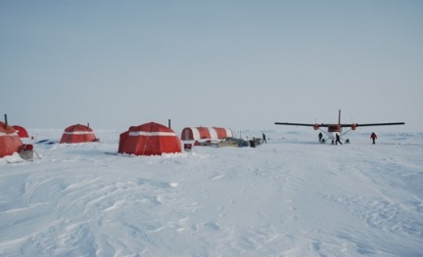
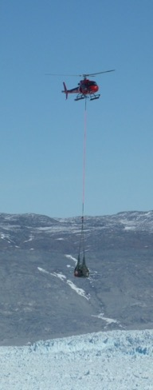
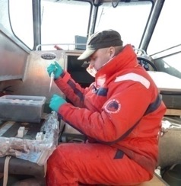
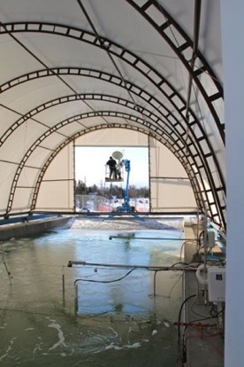
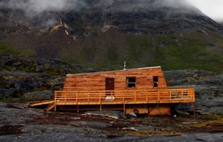
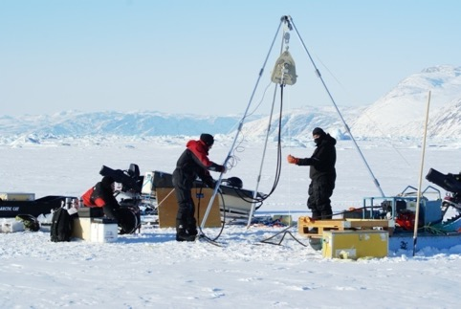
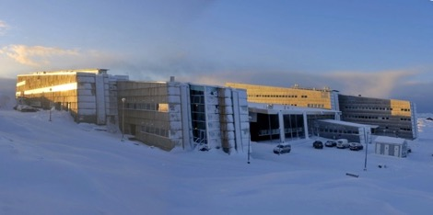
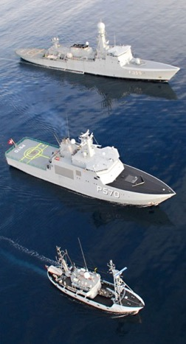
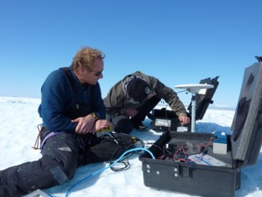
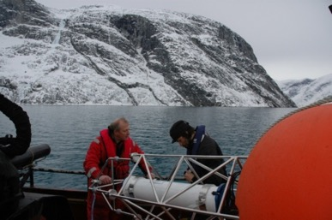
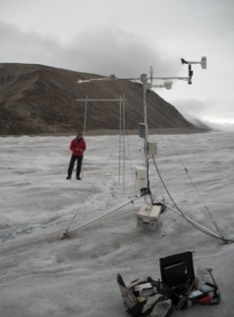
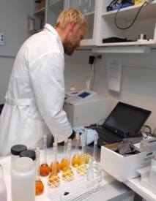
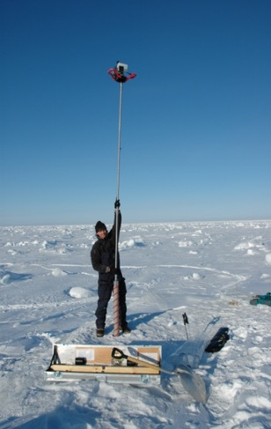
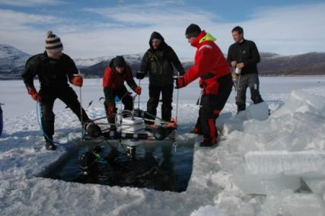
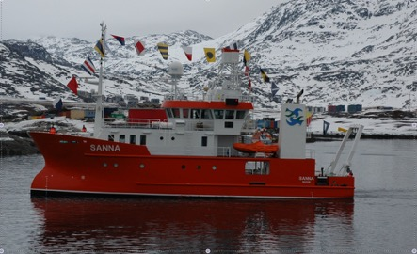
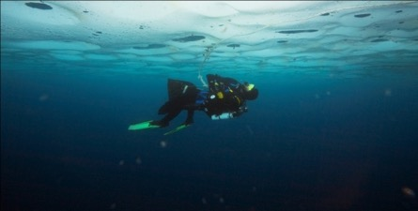

Slide 4
Field campaigns/projects 2012-21
2012: Young Sound
ASP Start-up campaign - March
2013:
Nuuk – 26 projects in Nuuk area
SERF – 3 projects
2014:
Young Sound – 14 projects
SERF – 3 projects
Nuuk – 1 project
Cambridge Bay – 14 projects
Amundsen – 5 projects
2015:
VRS Station Nord – 18 projects
Young Sound – 1 project
SERF – 3 projects
Amundsen – 7 projects
Green Edge – 2 projects
2016:
VRS Station Nord – 5 projects
Young Sound – 2 projects
SERF – 7 projects
Baffin Bay – 7 projects
Nuuk – 9 projects
Svalbard – 4 projects
Other projects – 7 projects
2017-2021:
VRS Station Nord – 9 projects
Young Sound – 4 projects
SERF – 6 projects
Greenland Sea – 4 projects
Nuuk – 8 projects
Svalbard – 5 projects
Baffin Bay – 8 projects
DCH – 8 projects
Other projects – 6 projects
2013- 2019
2013- 2019
2013- 2019
2013- 2019
2016- 2019
2015
2016 2017
2016 2017
2017-
2019
2013-2014
2016- 2021
2012-
2021
2021
2017-2019

Slide 5
Isaaffik – the Arctic gateway

Slide 6
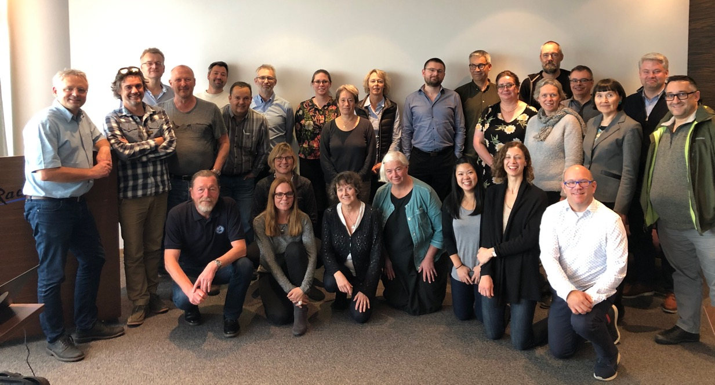
Annual ASP meetings
Reykjavik 2019

Slide 7
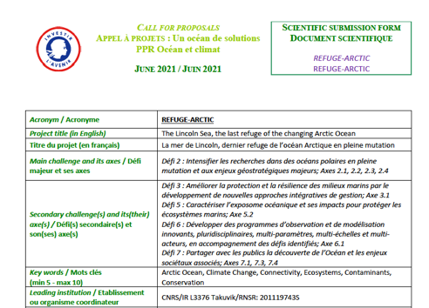
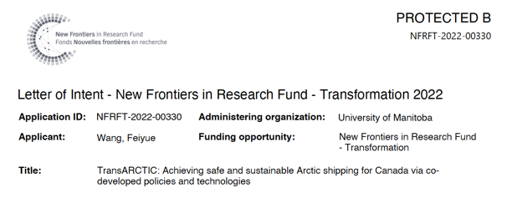
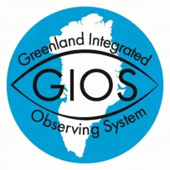
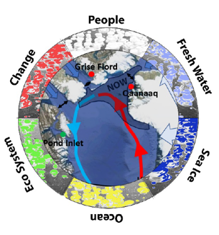
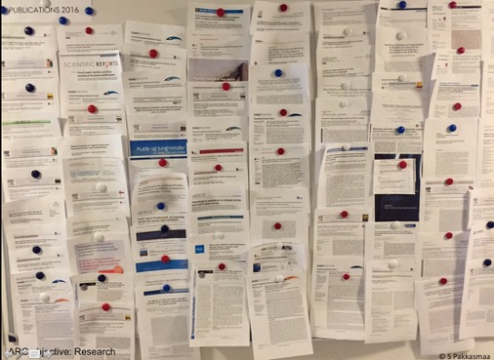
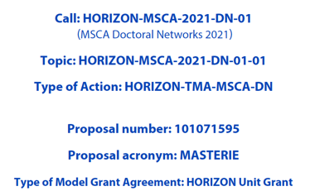
Main achievements Research
Joint applications
Joint publications
Baffin Bay North
Notes:
300 pages Basse bog, 556 pages Nuttal bog

Slide 8
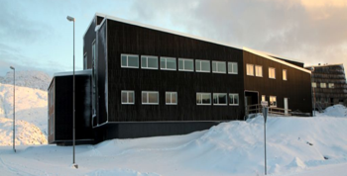
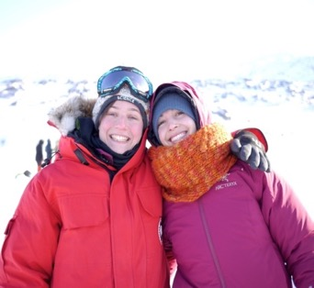
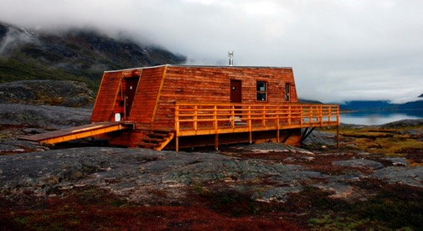
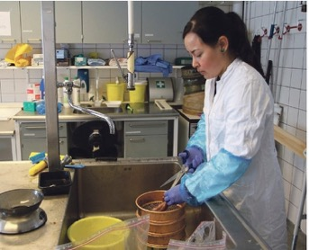
Main achievements Education

Slide 9
ASP field roadmap 2022-2029
2020 | 2021 | 2022 | 2023 | 2024 | 2025 | 2026 | 2027 | 2028 | 2029
Greenland National park – air-land-ocean campaigns
Greenland Integrated Observing System (GIOS)
Axel Heilberg Island
Lincoln Sea – Amundsen Refuge Arctic
Upernavik
ARTofMelt- Arctic Ocean
Greenland Sea (FRAM, NorthGreen, 79-fjorden
Hudson Bay & James Bay – Nelson river
Ice Stream-Marine Coupling
MEBO Vest Greenland
NOW – CERC & CFI UM
ArcticNet Annual Exp
NOW Baffin Bay Amundsen
East Greenland ECOTIP
iClimate idea – St Nord
Müllers ice cap
Svalbard (Polar Night, ABCD, Hausgarden)
Cambridge Bay (CHARS)
Knud Rasmussen east-west Greenland
Knud Rasmussen east-west Greenland
ARCTOME
RevOcean
Arctic-Antarctic
Churchill Marine Observatory (CMO)
Sea ice Environmental Research Facility (SERF) – Winter & CMO all year
Continuous field activities & monitoring programs, e.g. Godthåbsfjord, Young Sund, Ella Ø, Station Nord, Kongsfjorden, Rijpfjorden
04-Nov-2020

Slide 10
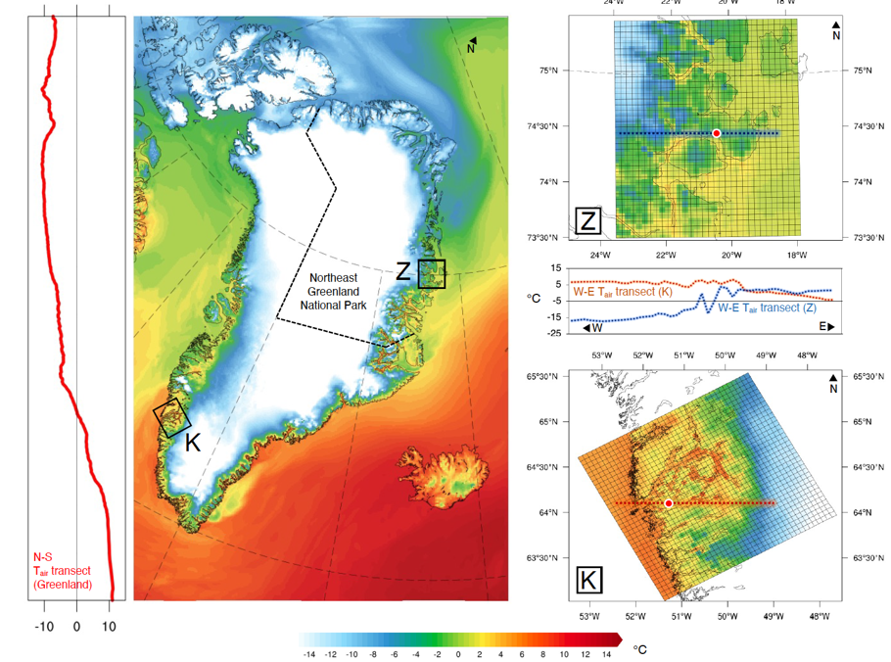
The idea behind a large regional cruise and field campaign activity
Use our combined infrastructure to understand climate gradients and learn from these
Downscaled air temperature at 5x5km spatial resolution from HIRHAM5 Regional Climate model of Greenland during August 1st 2000

Slide 11
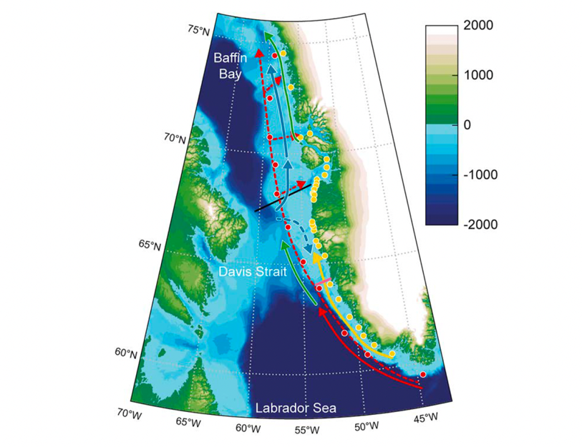
The idea behind a large regional cruise and field campaign activity
Use our ASP network to investigate regional differences
Rysgaard et al. 2020

Slide 12
Linking atmosphere and ocean
Mortensen et al. in revision

Slide 13
So how do we combine our forces on:
Predicting seasonal and interannual variation in atmosphere-ice-land-ocean conditions and their interaction?
Joint cruises and field campaigns to increase understanding of regional differences?
Existing activities (e.g. BBN, TARA, GIOS, CERC, EGRIP etc) to enhance our knowledge?
Selecting a few key parameters to measure

